Slide 1
Learnability

Slide 2
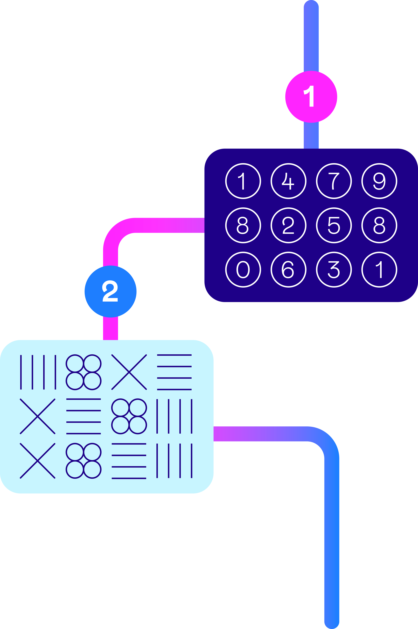
Overview of Beta-Learnability
  Online cognitive assessment designed to measure ability to learn
  Questions in the assessment are interconnected and progressively more difficult
  After a question is answered, the correct response is presented which forms part of the next, more difficult question
  Throughout the test, the test taker observes data, learns its underlying patterns, and applies their learning to solve problems
  Consists of 13 questions
  Approx. 18 minutes time to complete
  Practitioner and Candidate reports are available

Slide 3
Constructs & Roles
The test measures the ability to learn through observing data,
learning underlying patterns, and applying their learning to
solve problems.
This type of ability is required in roles that place a strong emphasis on the ability
to learn. For example,
Roles where candidates may be required to learn and acquire new knowledge and skills
Roles where candidates may need to analyse and interpret data and patterns but do not have experience with specific tools and platforms e.g. analytics roles.
The assessment has been designed to help make decisions about those applying for graduate, professional, and managerial roles (in roles where the specific criteria above is important).

Slide 4
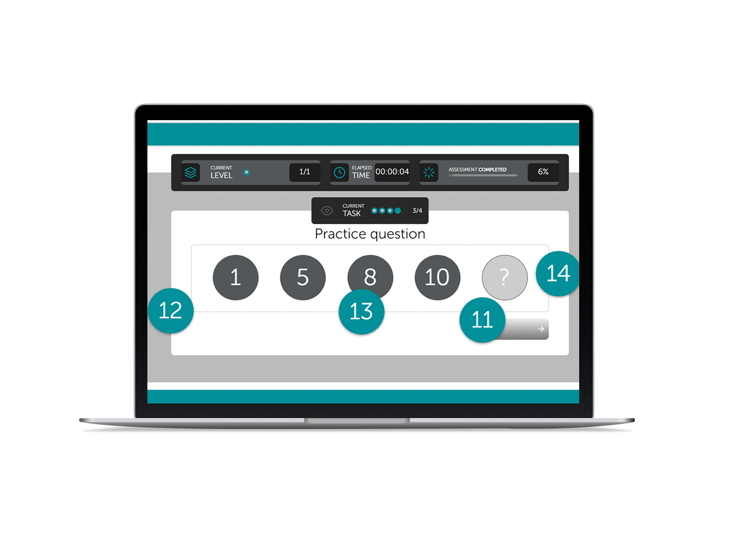
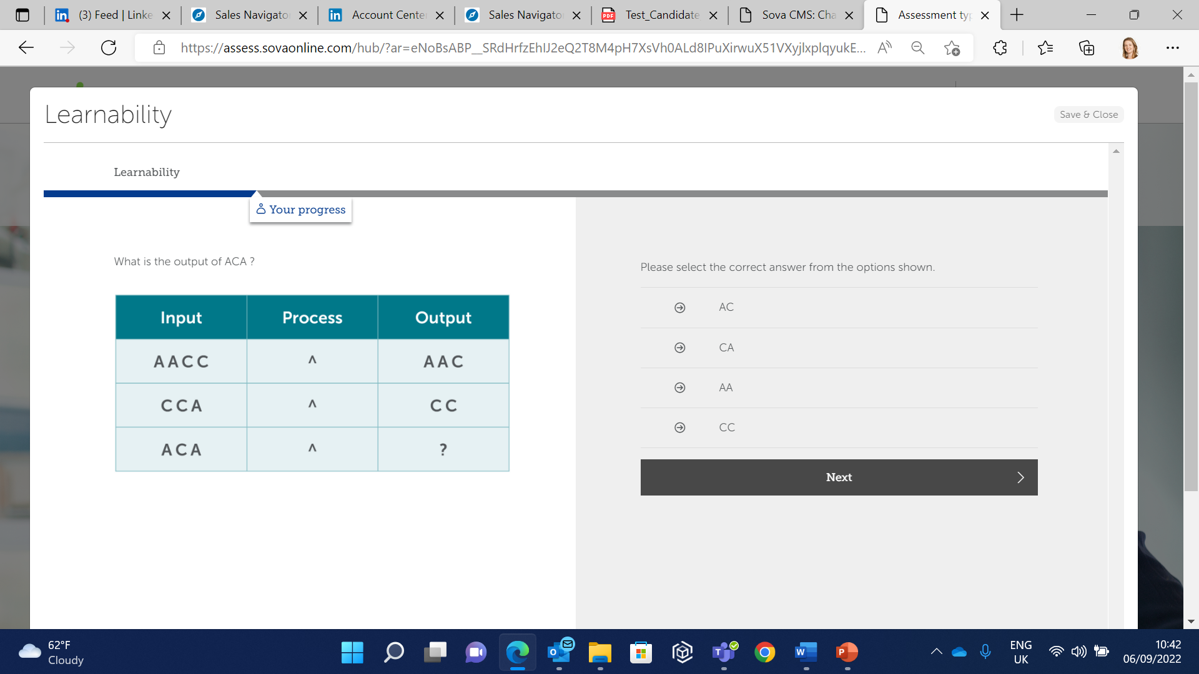
The assessment
  Test takers are presented with a series of question blocks or ‘testlets’
  Questions contain either numbers, symbols, or words, to present an underlying pattern
  Test takers choose the correct response from the presented options. As they progress to the next question in the block, the answer to the previous one is shown in order that the candidate can reflect and learn.
  Test takers use this information to solve the next, interconnected question in the testlet

Slide 5
Psychometric Properties
  Criterion Validity
  Reliability
  Criterion validity concerns the relationships between scores on an assessment and desired workplace outcomes, for example, job performance.
  Working with a large banking client, existing employees were asked to take the Learnability assessment and their line managers rated their job performance on Thinking Ability and Ability to Learn.
  Reliability concerns the precision of an assessment. Cronbach’s alpha is typically used to measure reliability (or internal consistency of questions) and the typical industry acceptable level is 0.7
  Cronbach’s Alpha
  Learnability
  0.71 (n = 1444)
  Learnability
  Thinking Ability
  0.26**
Construct Validity
  Ability to Learn
  0.20
  Numerical Reasoning
  n = 96, **p<0.01
  Learnability
  0.47** (n = 1049)

Slide 6
Beta-Learnability Assessment Fairness
  Assessment Inter-correlations
 | Effect size*
Female | -0.21
Asian | -0.02
Black | -0.53
Mixed | -0.04
20-29 | 0.19
30-39 | 0.01
40+ | -0.31
* When compared with males, white, and the ‘under 20’ group.

Slide 7
Norm Data
N=7,282
UK population, mainly grads with some apprentices and career changers
  Gender
  Age
  Ethnicity

Slide 8
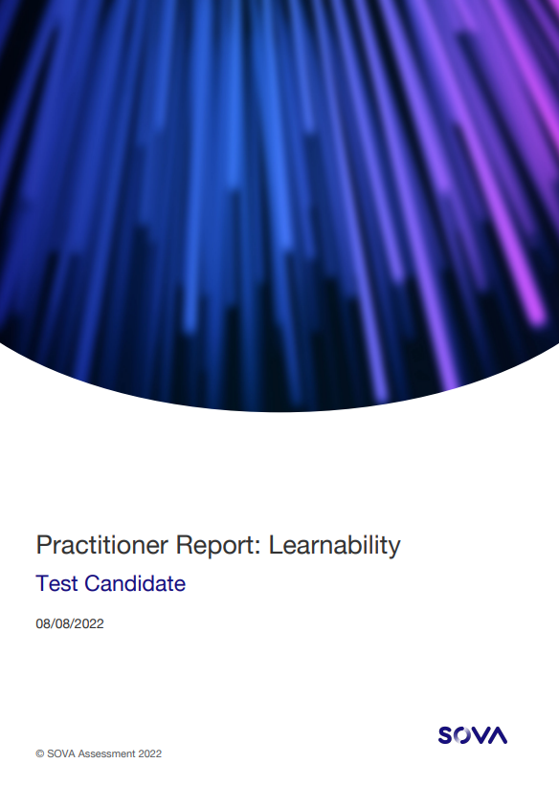

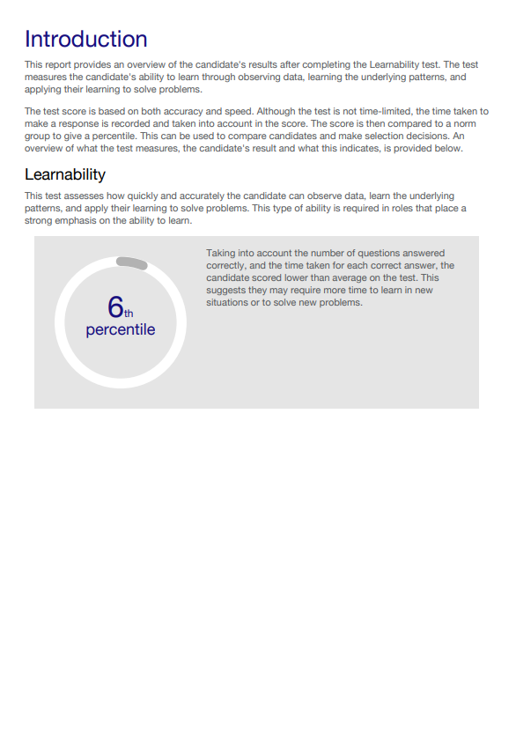
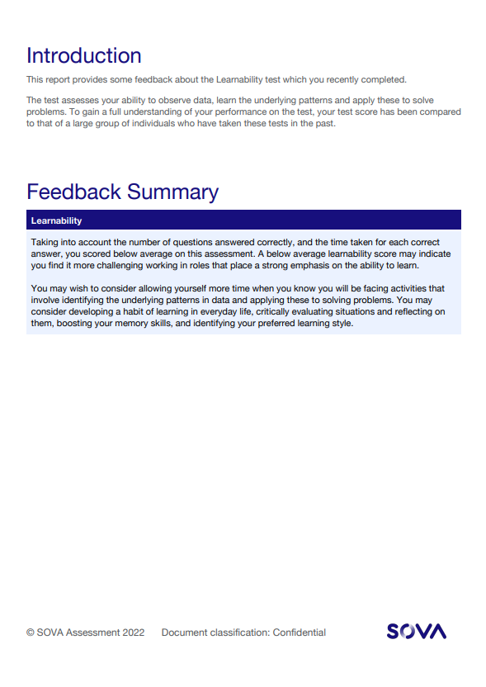
Learnability Reports
  Practitioner and Candidate reports are available

