Slide 1
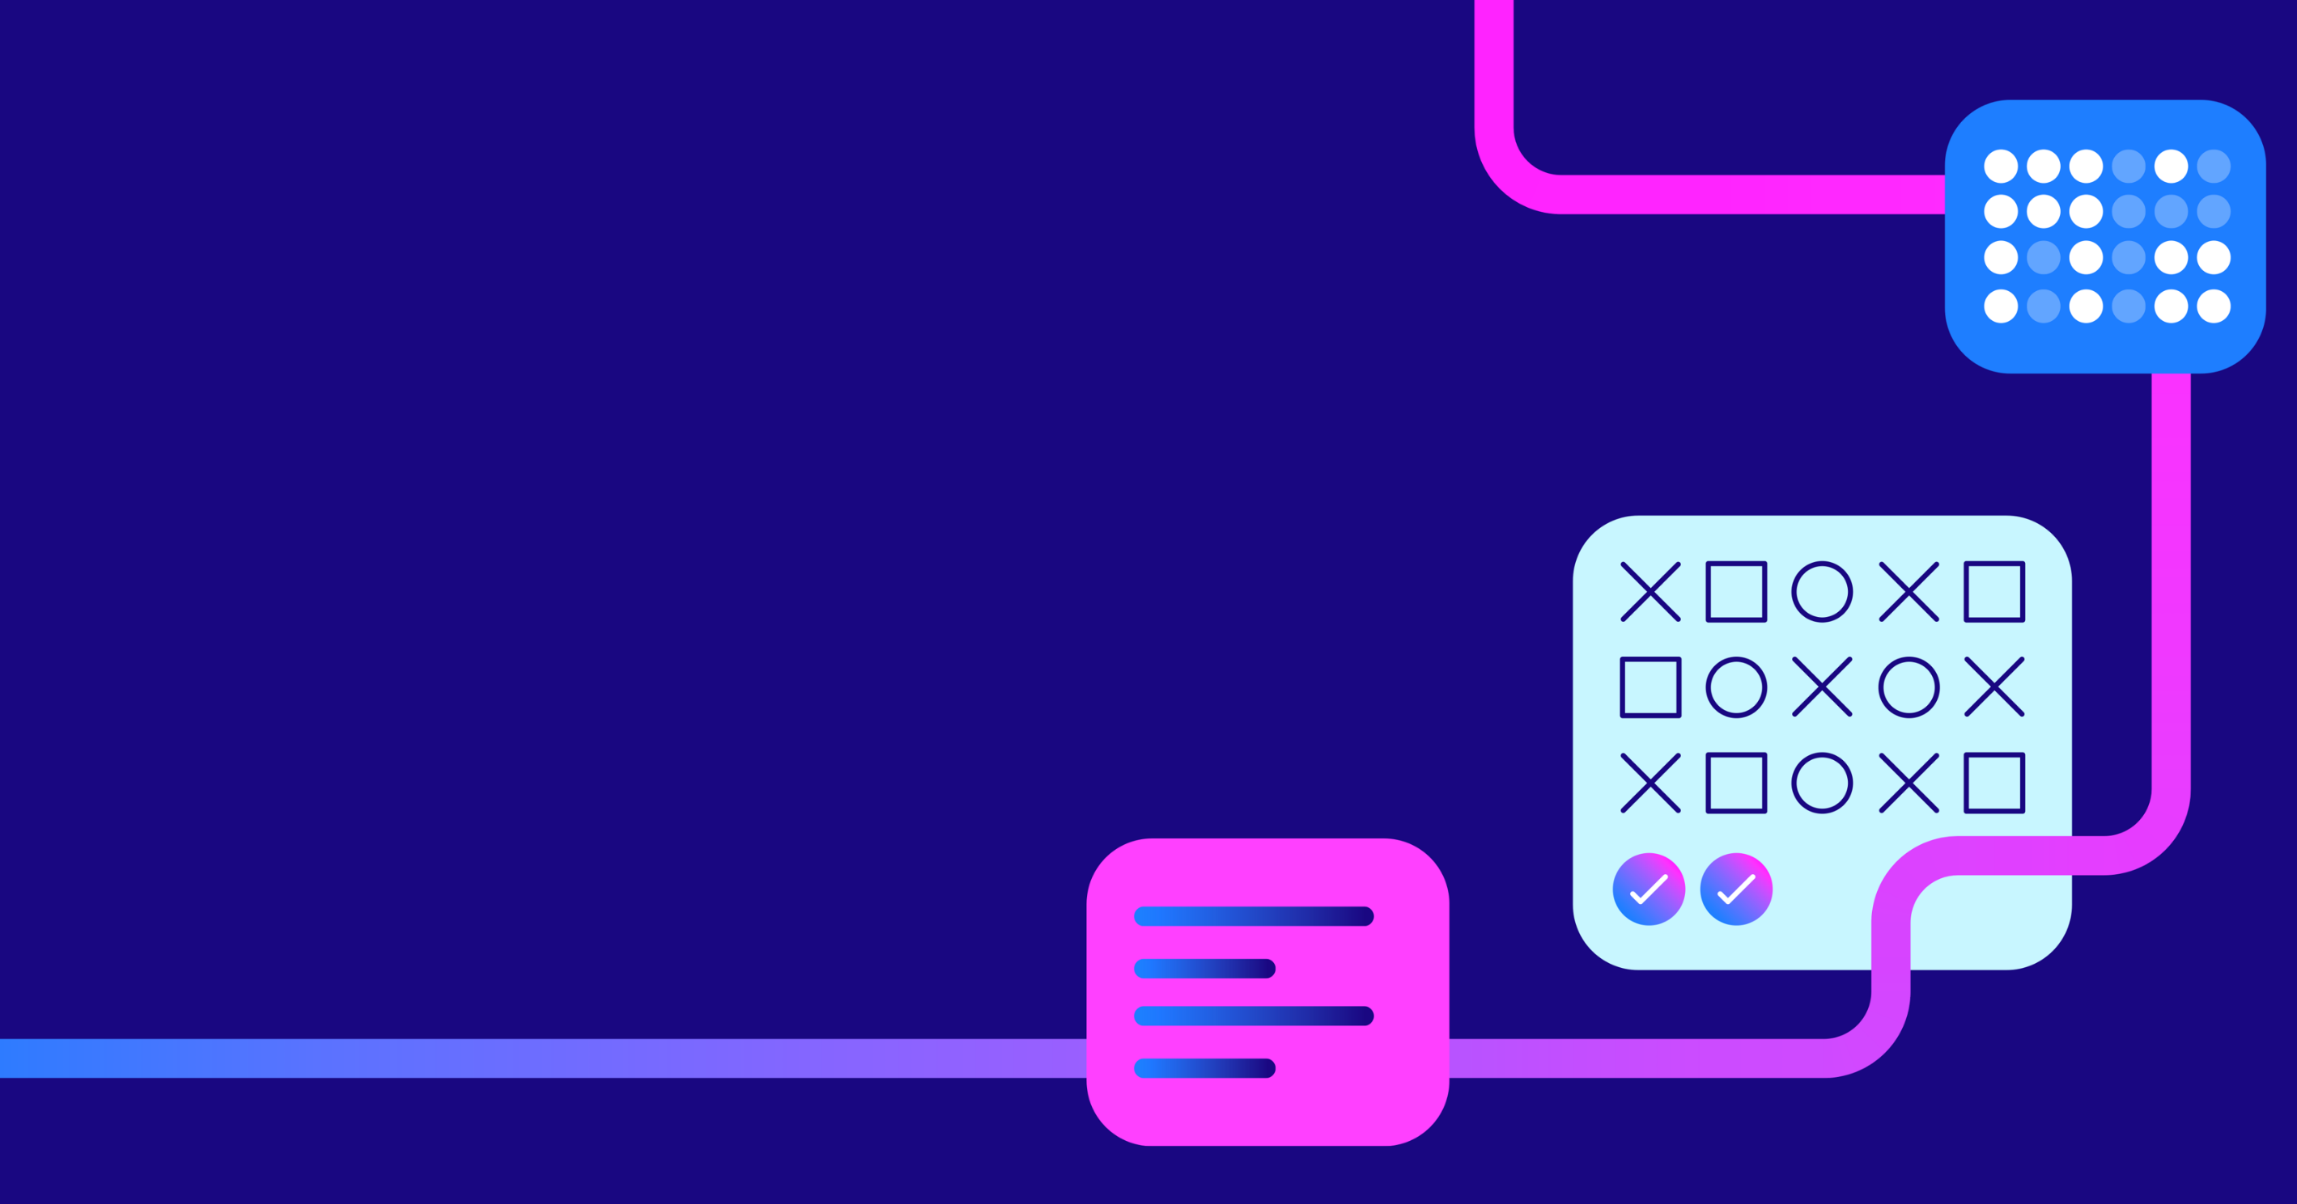

Sova’s Gamified
Assessment

Slide 2
Literature on Gamified / Gamification
  Assessment Gamification is the process of adding game design elements to assessment (i.e. levels, points, leader boards, badges, etc.) to make the assessment process more engaging.
  Gamification can be conceptualised as a continuum (Wu, 2014) where on one end you can modify an existing non-game assessment by adding game elements while the other end are game-based assessments that offer a full gameplay experience.
  Sova
  Challenges
  Gamification Continuum
  Add Game
  Elements
  Full Gameplay
  Experience

Slide 3
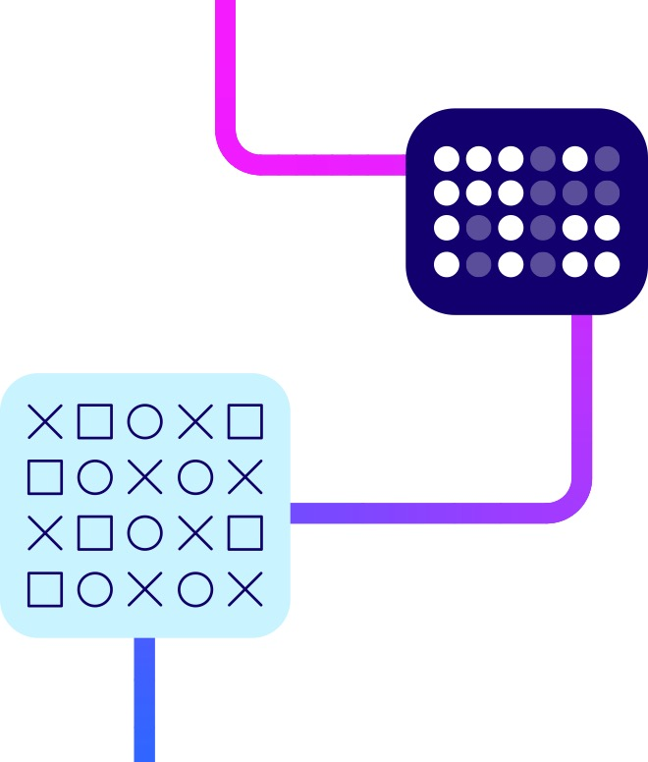
Literature on Gamified / Gamification
  The use of gamification in selection situations is on the rise and research in the area is catching up.
  Some gaming elements are unsuitable for selection assessments and could unintentionally introduce bias, particularly for candidates with information processing difficulty or visual or hearing impairment. Example elements include:
  Excessive colour
  Sounds
  Movements
  At Sova, we believe the gamification of psychometric assessments should be done meaningfully for it to not only create an engaging experience but also remain valid, reliable, and fair.

Slide 4
The Balance between Recruiters’ needs and Candidates’ needs
  Recruiter’s Needs:
  Robust
  Accurate
  Fair
  Psychometrics
  Candidates’ Needs:
  Engaging
  Process holds their
  attention
  Modern, quick process

Slide 5
With Sova Challenges, there’s no need to compromise…
  The gamified experience offers better candidate engagement.
  Still allowing candidates to perform their best and recognising the recruitment process is serious
  Candidates’ Needs:
  Engaging
  Process holds their
  attention
  Modern, quick process
  Our focus on science and psychometrics hasn’t changed.
  Sova Challenges still meet the high standards we set for fairness, reliability and validity

Slide 6
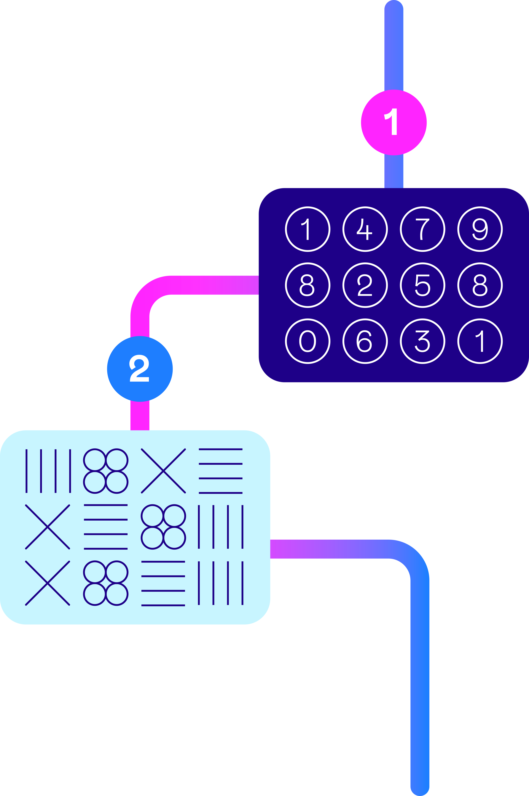
Sova Gamified Assessment Overview
  Online cognitive assessments designed to predict job performance in a range of roles
  Two tests:
    Number Challenge (12 items, up to 15 minutes)
    Pattern Challenge (12 items, up to 15 minutes)
  Built upon strong psychometric principles using validated constructs of ability (numerical and logical reasoning)
    Both constructs have track record of predicting success across multitude of roles
    Test length ensures sufficient items for scores per assessment
  Innovative question format using game-based concepts whilst retaining professionalism
    Incorporates levels, progression, tasks and timing and different types of interactivity
  Practitioner and Manager Reports for both assessments

Slide 7
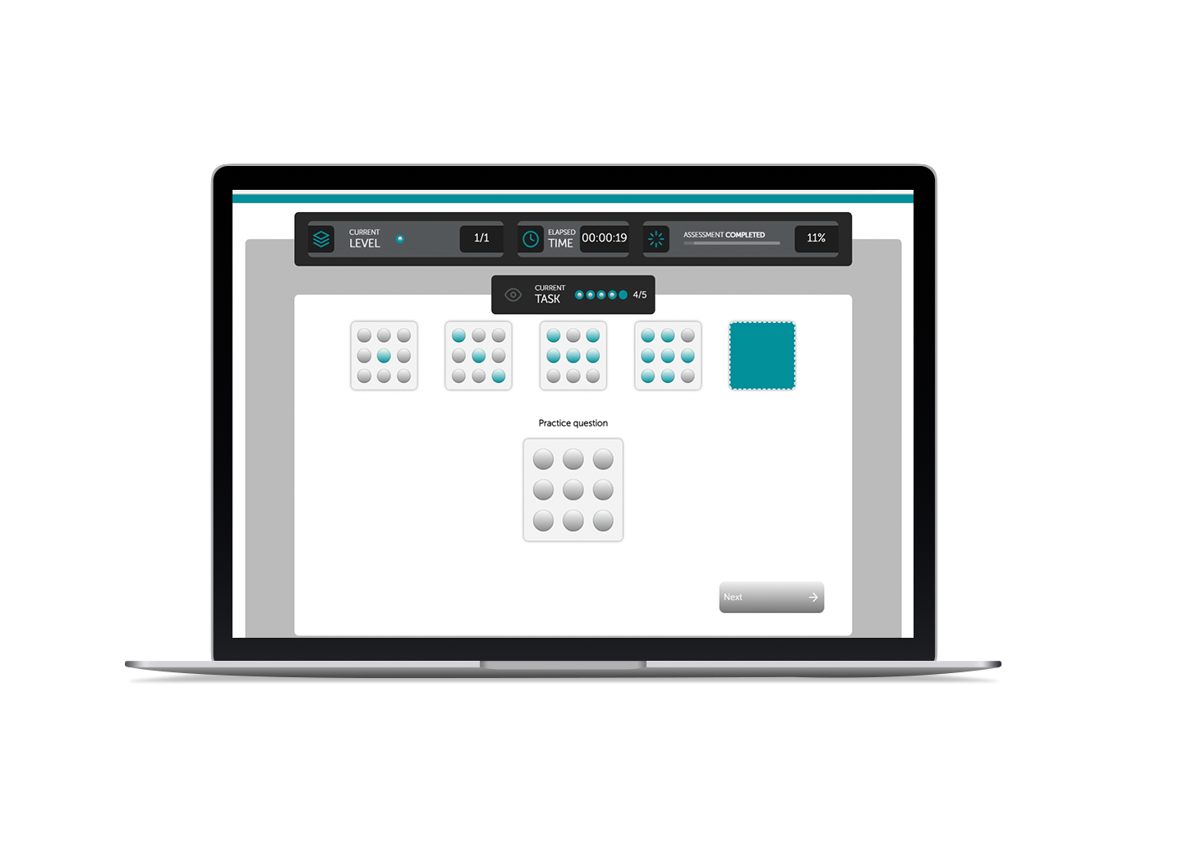
Pattern Challenge
  Candidate presented with a sequence
  of tiles, filled with patterns
  One tile is blank so the candidate can work out what the missing pattern should be
  Candidate creates their own pattern by clicking buttons on screen
  Less opportunity for guessing and offers candidate more freedom of choice.
  By not offering fixed responses, less susceptible to over-exposure of items

Slide 8
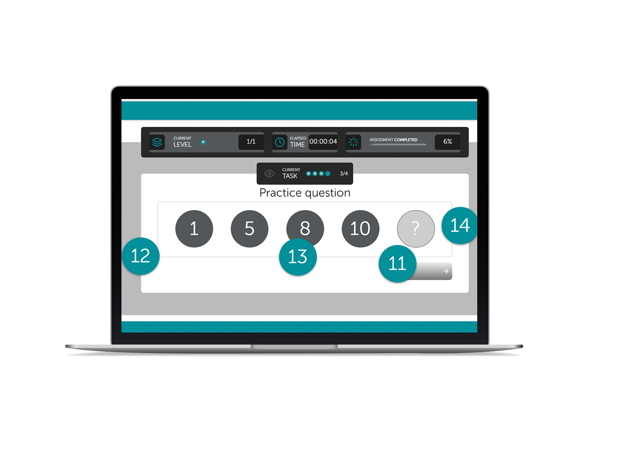
Number Challenge
  Candidates are presented with a
  number sequence
  One number is missing from the sequence and candidate is required to work out what it should be
  Candidate chooses from a series of numbers floating on screen and uses
  drag and drop functionality to respond
  By using drag and drop, engagement increases but the underlying ability required to answer remains the same psychometrically
  Randomisation reduces item exposure

Slide 9
Psychometric Properties
  Reliability
  Assessment Inter-correlations
  Reliability concerns the precision of an assessment. Cronbach’s alpha is typically used to measure reliability (or internal consistency of questions) and the typical industry acceptable level is 0.7
  Patterns of correlations between constructs is an important consideration for construct validity, as it measures how closely related different constructs are to each other. We expect a degree of correlation between ability assessments as they tap into general intelligence (known as ‘g’). The relationship between Sova’s Pattern Challenge and Number Challenge suggests they are sufficiently different with an expected amount of overlap.
  Cronbach Alpha
  Number Challenge
  Number Challenge
  0.71 (n=1000)
  Pattern Challenge
  0.38**
  Pattern Challenge
  0.76 (n=2587)
  n = 2113, **p<0.01

Slide 10
Gamified Assessment Fairness
  Sample of 2587 people completing both tests
  Small effect size differences between males and females
  Very small score differences between age groups
  Assessment Inter-correlations

Slide 11
Norm Data
N=2592
Graduate population
  Gender
  Age

Slide 12

Candidate Experience
  In a recent client engagement…
71%
74%
  of candidates ‘agreed’ or
  ‘strongly agreed’ that they
  enjoyed the assessment
  of candidates ‘agreed’
  or ‘strongly agreed’ that they
  found the assessment engaging

Slide 13
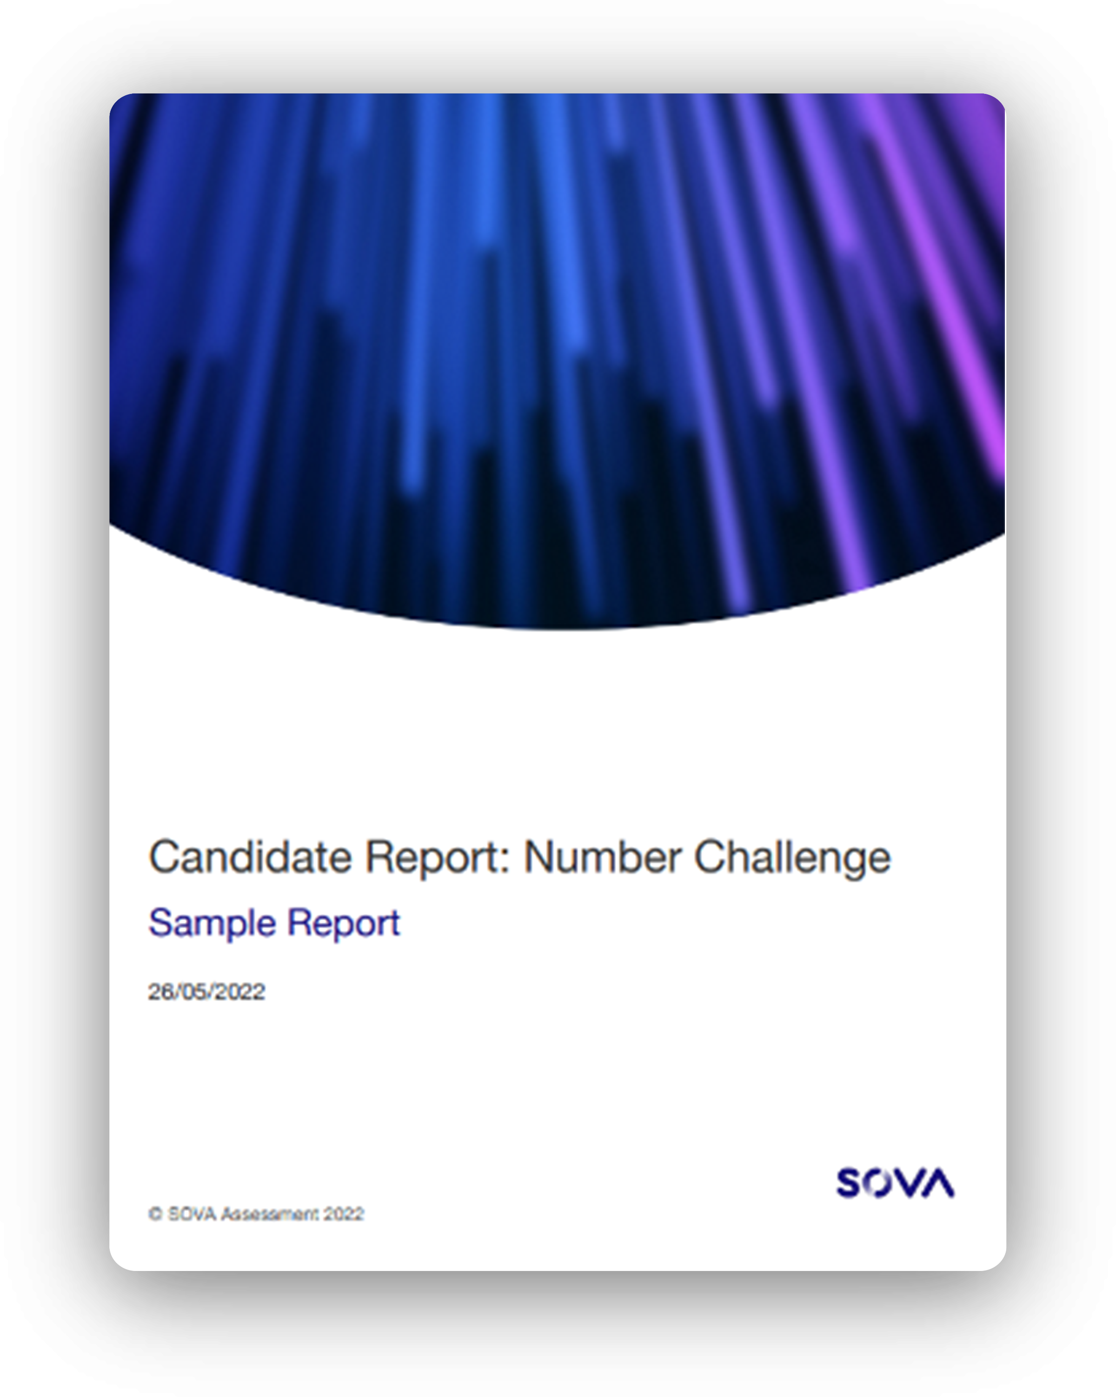
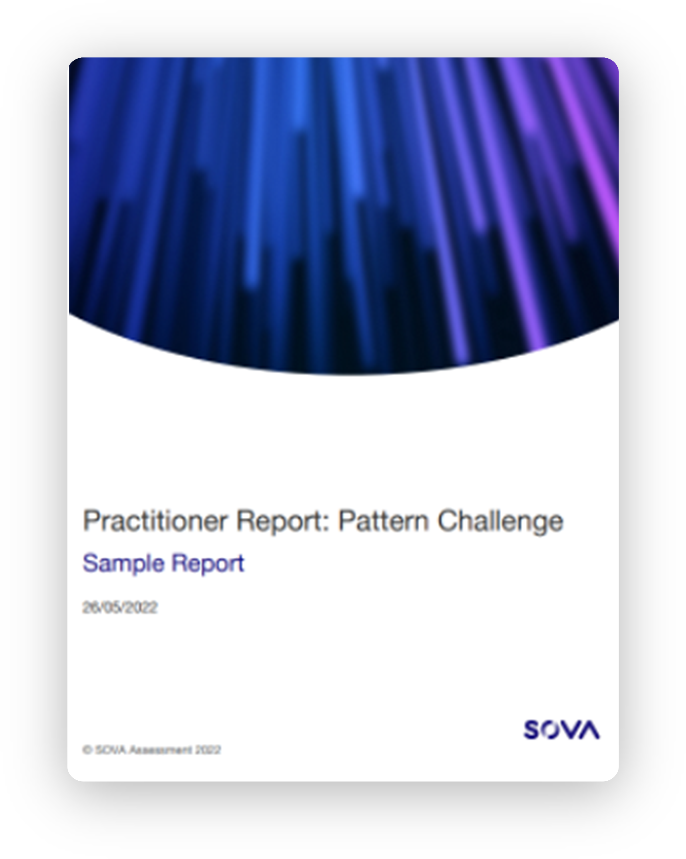
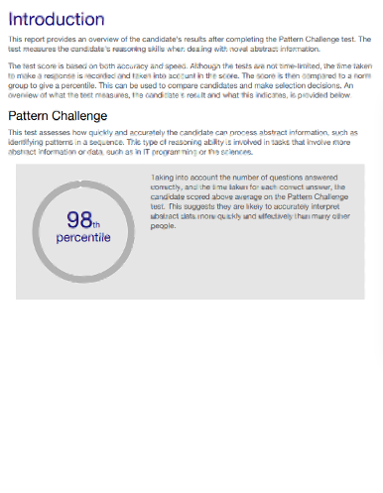
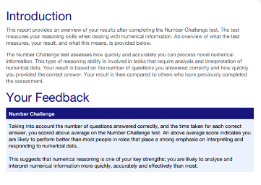
Gamified Reports
  Candidate and Manager reports are available for both tests

Slide 14
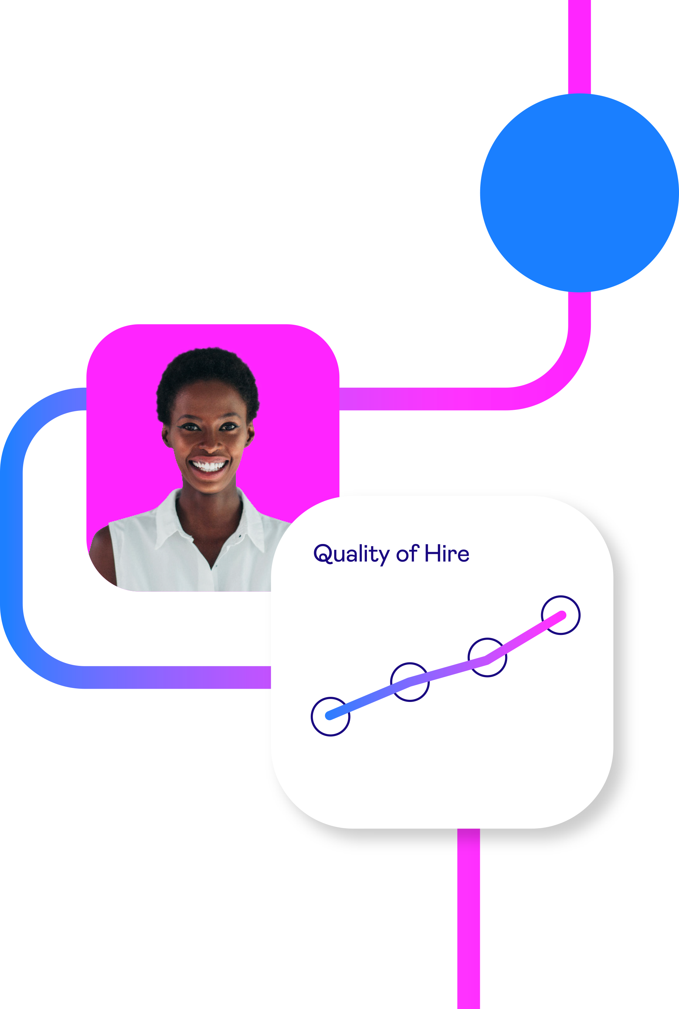
Off-the-Shelf or as part of a solution
  Our two Gamified Challenges are available and ready for clients to use either:
    Off-the-shelf – current design means they require a hot spot per assessment
    Part of a blended assessment – we can reduce the number of item and include alongside SJTs,PQ etc.
  The gamified assessments operate at a similar level of difficulty as our standard ability assessments.
  Gamified is best used in circumstances where a more immersive candidate experience is required, often graduate hiring for example. Lower-level roles can be assessed using our High Volume suite of assessments.

