Slide 1
Sova’s Motivation Questionnaire

Slide 2
Employees are re-thinking their positions…
54% of Gen Z employees and 41% of the entire global workforce are about to quit their jobs*
65% of employees say the pandemic has made them rethink the place that work should have in their lives***
47% of those surveyed are looking for a new job that provides clarity and growth opportunities**
*Microsoft 2021 Work Trends Index: Annual Report
**Lattice, August 2021: The Greatest Mass Resignation in Modern Times Isn't Just About COVID or Burnout
***Gartner, December 2021. Great Resignation or Not, Money Won’t Fix All Your Talent Problems

Slide 3
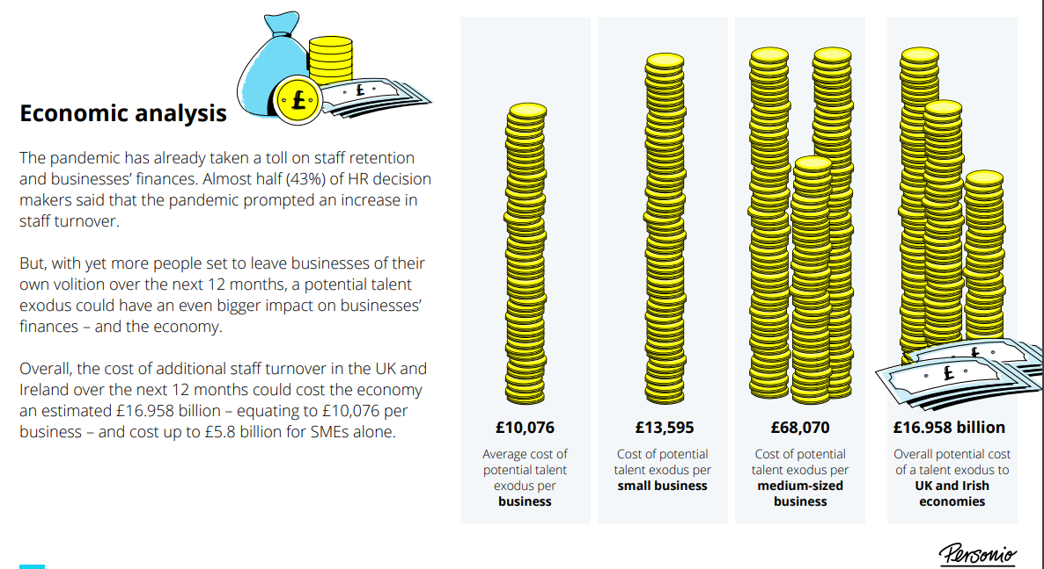
The cost of this on businesses and the economy is huge…
Personio & Opinium, March 2021. Counting the Cost: How Businesses Risk a Post Pandemic Talent Drain

Slide 4
Businesses need to re-understand employees to retain top talent
52% of respondents said the pandemic made them question the purpose of their day-to-day job*
“The talent landscape has shifted, and employee expectations have changed. The best leaders will empathise with the unique needs of each group in their organisation.”
Microsoft 2021 Work Trends Index Report
50% said the pandemic changed their expectations of their employer*
*Gartner, December 2021. Great Resignation or Not, Money Won’t Fix All Your Talent Problems

Slide 5
Why Measure Motivation?
Having meaningful work has been shown to play key role in …
Discretionary Effort
Performance
Job Satisfaction
Retention
Employee Engagement

Slide 6
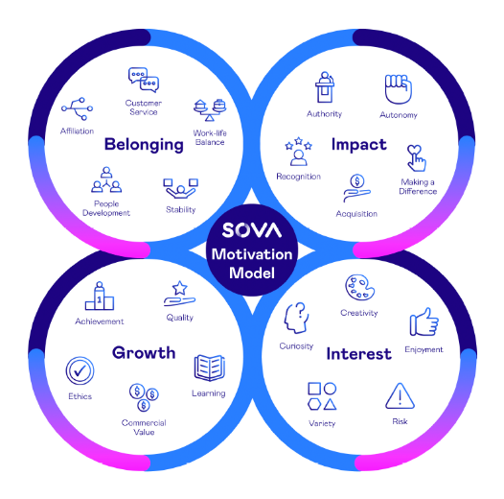
Sova’s Motivation Questionnaire
Measures the key factors that stimulate and energise people in the workplace.
Four reports are available:
Practitioner Report – profile chart of scores on all 20 scales, general overview of their scores, implication of the key motivators and their ideal/least ideal work environment.
Manager Report – How to work with and manage this individual and how their motivators affect their relationships at work.
Coaching Report – profile chart of scores on all 20 scales, upsides and downsides of key motivators and suitable coaching questions.
Candidate Report – ‘your top 3 motivators’ and overview of the scores on all 20 scales.

Slide 7
Motivation and Personality
What are people’s behavioural preferences? Reflect someone’s preferred ways of behaving, thinking and feeling
Personality assessments
What drives people to behave in certain ways? Reflects underlying needs, aspirations and goals plus what is needed in order to feel that work is meaningful
Motivation assessments

Slide 8
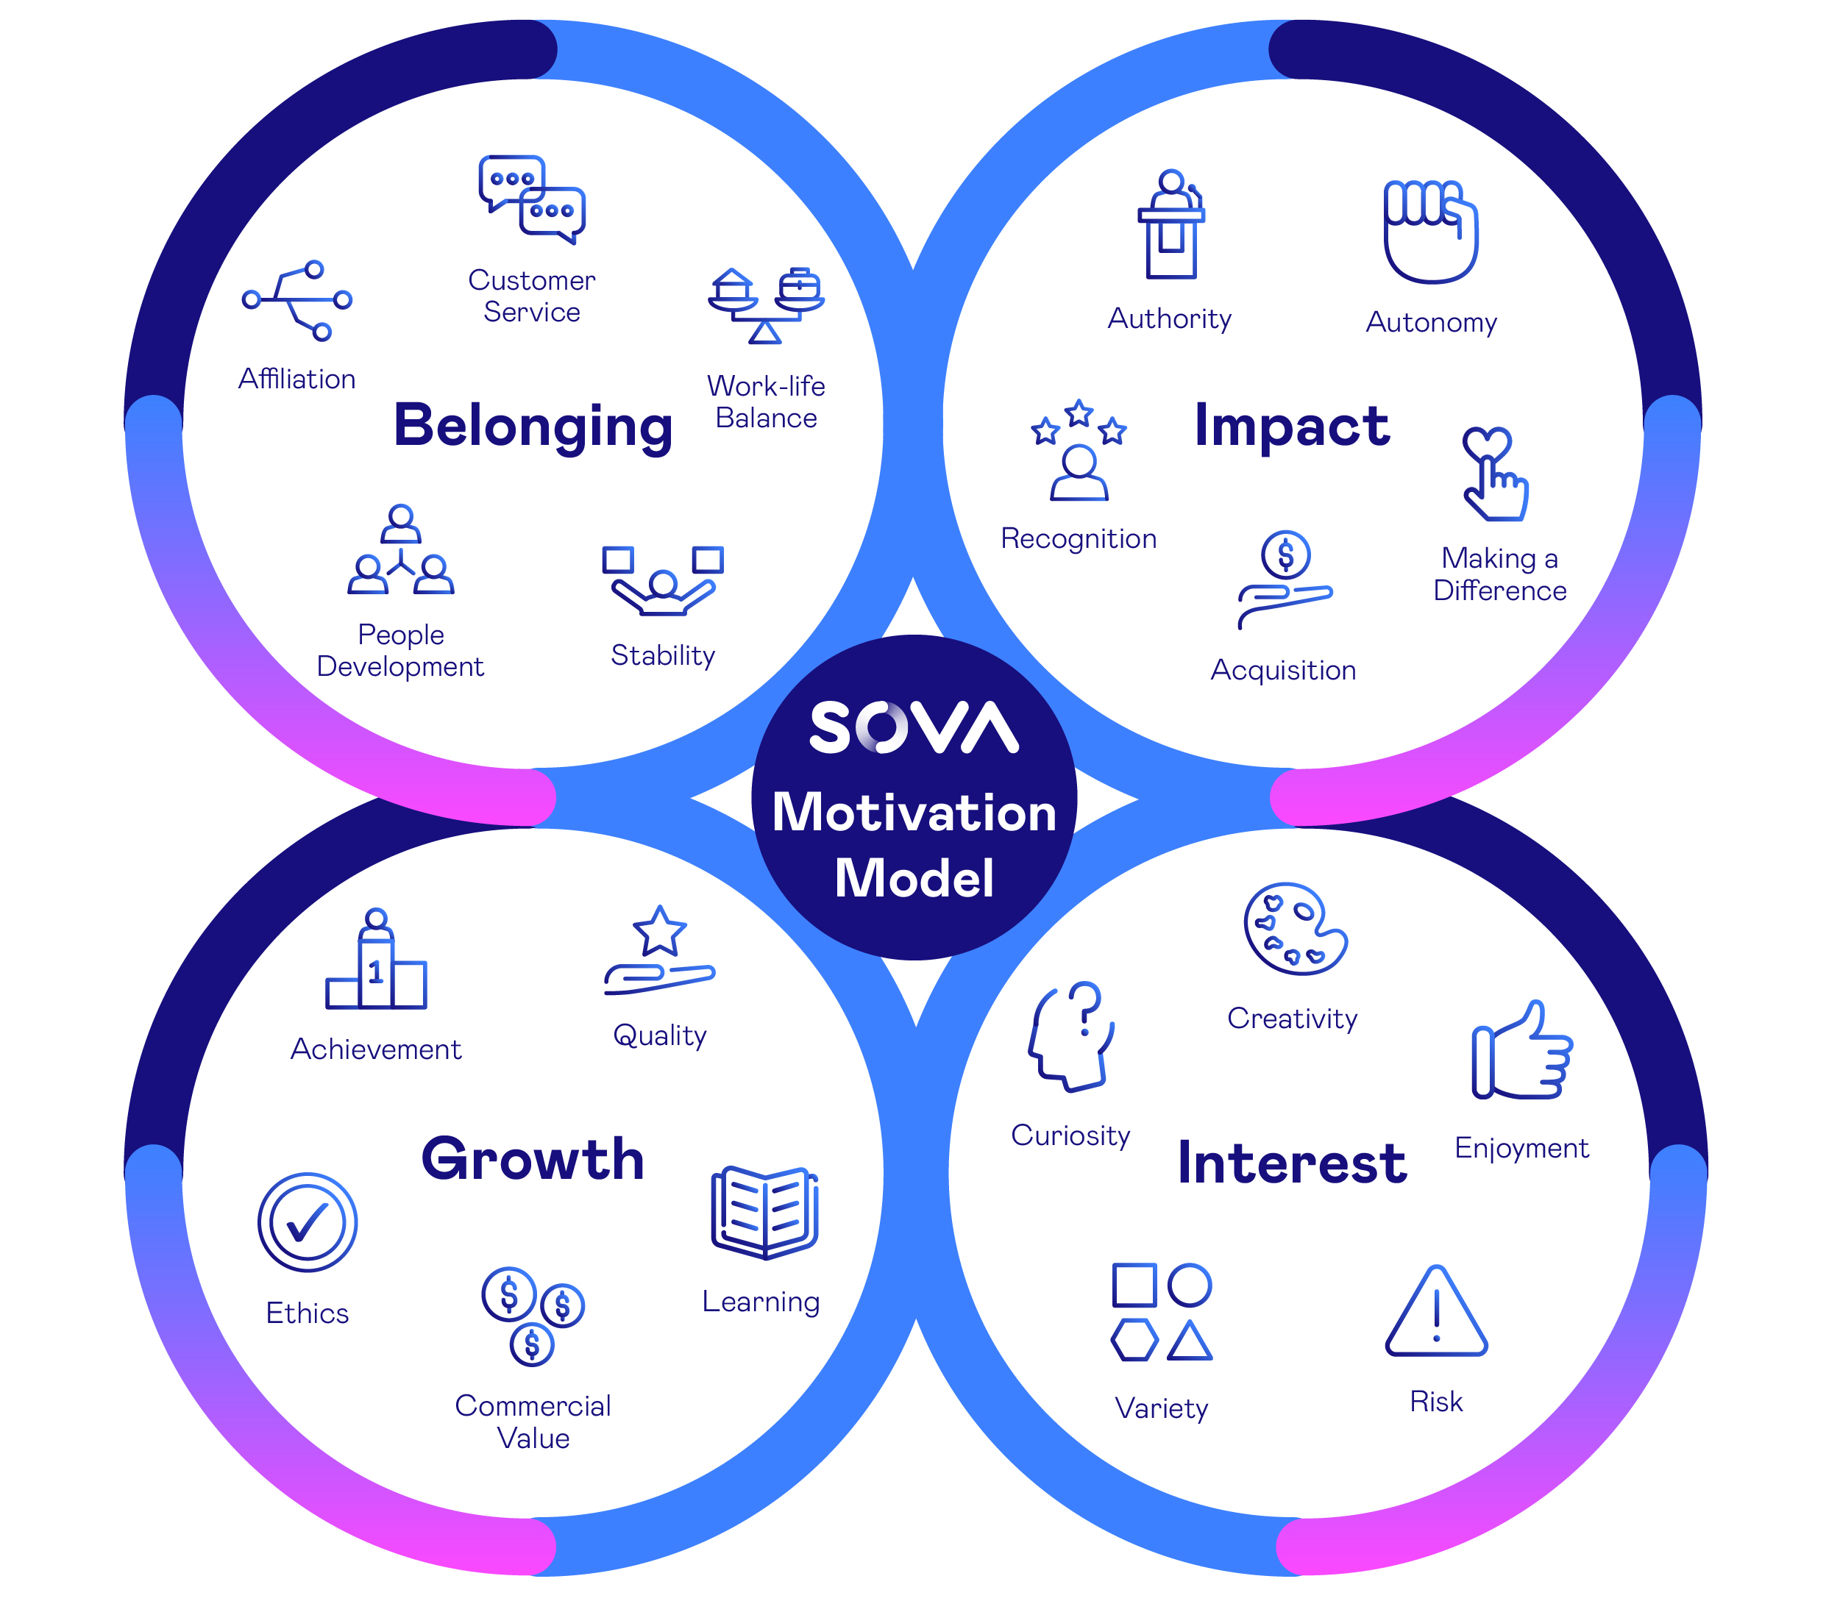
Sova’s Motivation Model
Sources of connection and sense of community
Sources of self-value and sense of worth
Sources of personal challenge and sense of triumph
Sources of personal satisfaction and sense of immersion

Slide 9
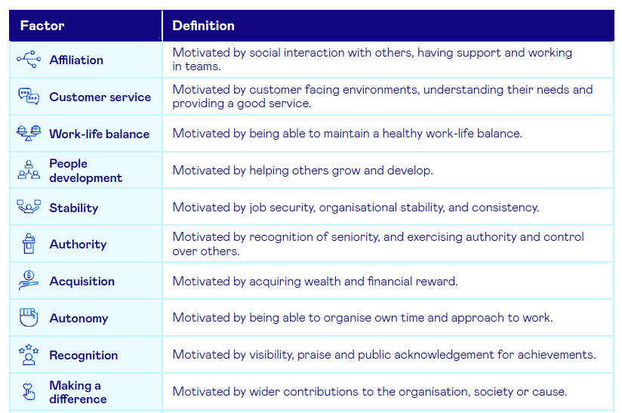
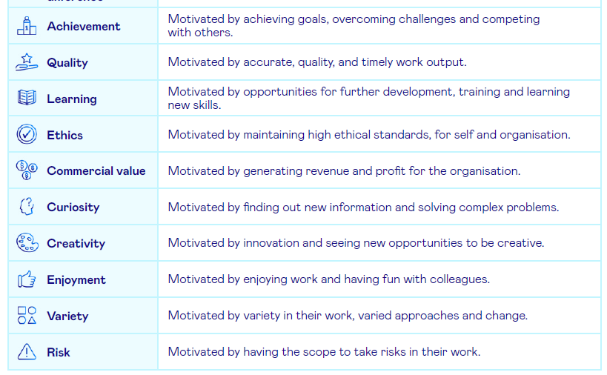
The 20 Factors

Slide 10
Reliability & Validity
Global talent acquisition company, 46 completions
Temporary customer service staff in Customer Service & Advisory and Processing & Administrative roles
Context and Sample
Blended assessment (PQ + MQ items) mapped to 7 key competencies
4 MQ factors assessed: customer service, curiosity, quality and stability
Plus questions relating to work engagement and intention to quit
Methodology
Findings
Using Cronbach’s Alpha, average reliability amongst the 20 MQ factors is 0.84
We’re always looking for partners to add to our research portfolio

Slide 11
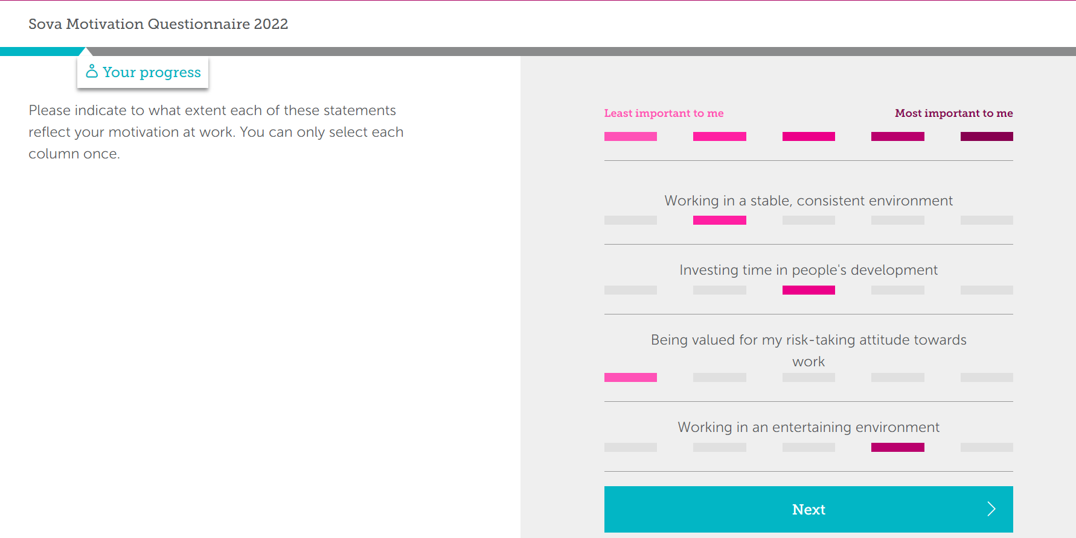
Example Question

Slide 12
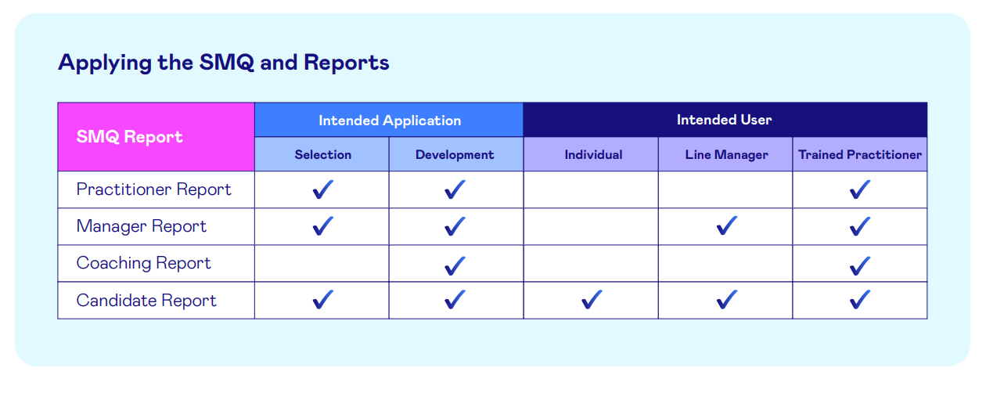
Reports available

Slide 13
Practitioner Report
What will energise and engage this candidate?
What are the practical implications of what motivates them and what doesn’t?
What aspects of the organisational environment will help them to thrive?
Selection uses:
Likely fit with organisation and role
Factors helping/impeding satisfaction and/or engagement
Insights into likely impact on attrition/retention
Developmental uses:
Talent management programmes, talent mapping and pipelining, executive coaching, career guidance or coaching, and outplacement

Slide 14
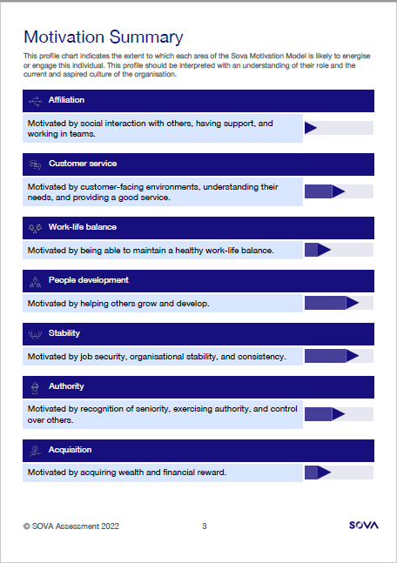
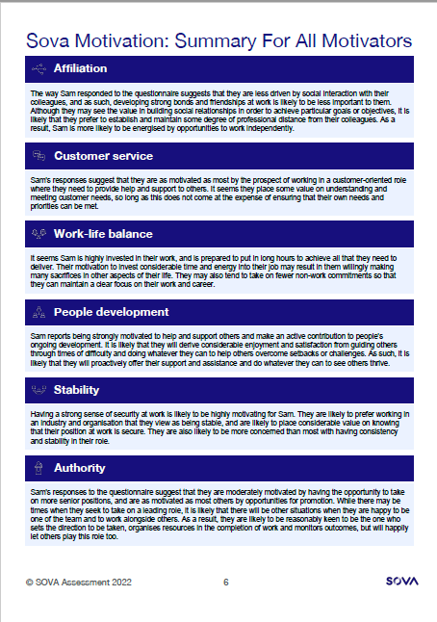
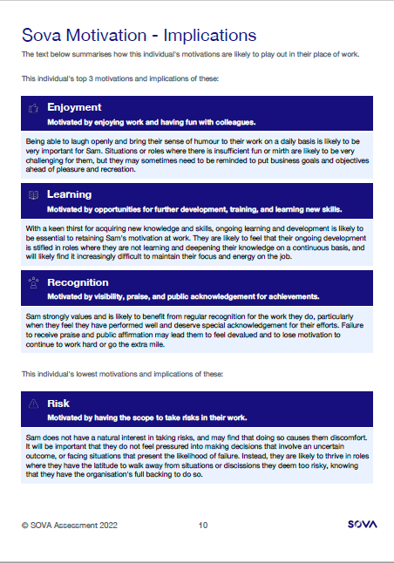
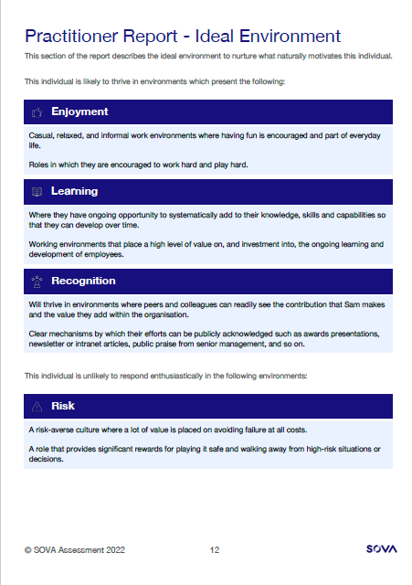
Practitioner Report

Slide 15
Manager Report
Based on a candidate’s top 3 motivators:
How can I best work with this person?
How can I keep them motivated over time?
Selection uses:
Features practical tips and guidance that managers can implement from ‘day 1’
Potential impacts on workplace relationships to be aware of up front and plan for
Key tool for engagement and retention!
Developmental uses:
Longer-term engagement via playing to key motivators
Monitoring and managing risks associated with potential negative team impacts
Monitoring and capitalising on opportunities associated with potential positive team impacts

Slide 16
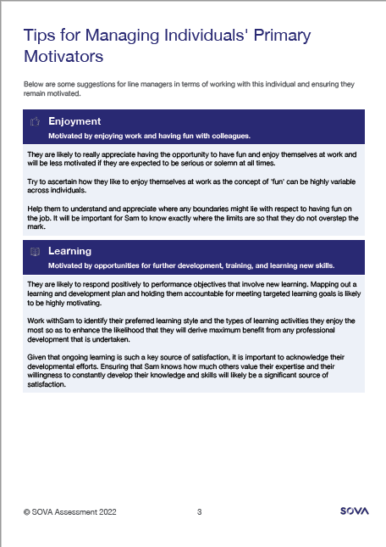
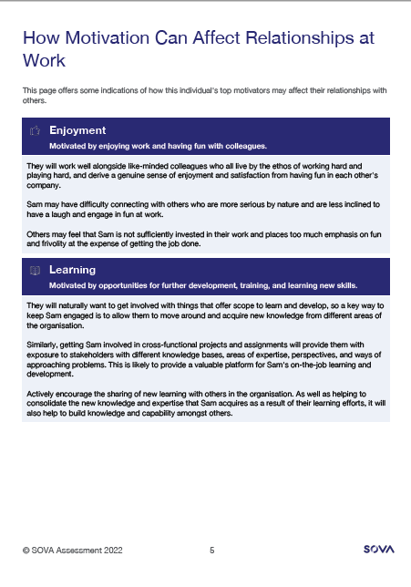
Manager Report

Slide 17
Coaching Report
Intended for use within a facilitated coaching session between an individual and a qualified coach
How are my motivational preferences likely to energise or engage me over time?
Developmental uses:
Primary motivators and their likely benefits + potential developmental considerations
Current role and organisation and the degree to which these are aligned to motivators
Potential reasons for current job or career-related challenges or dissatisfaction
Key factors to take into account when looking to change roles, organisations, or careers
What to include in a development plan that will help lay the foundation for career development, enrichment, advancement, or perhaps even broader career change/refocus.

Slide 18
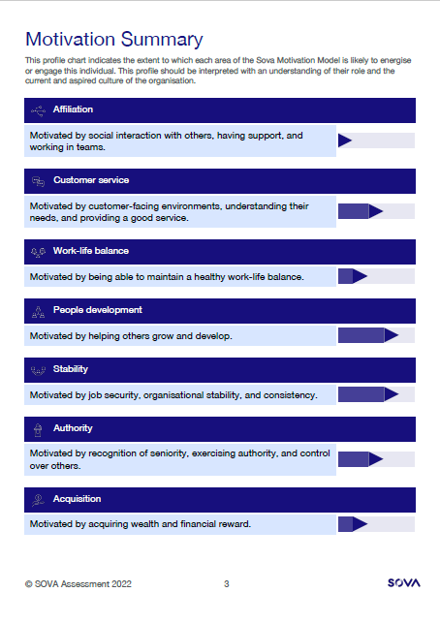
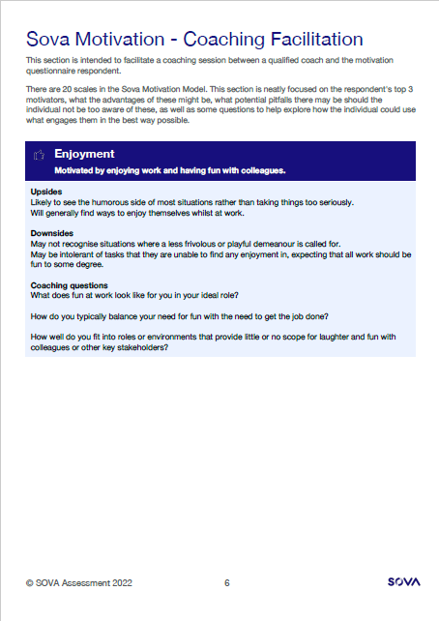
Coaching Report

Slide 19
Candidate Report
What factors are likely to affect my motivation at work?
Selection uses:
What to be aware of walking into a new role or in my ongoing job search
Developmental uses:
Assessment packages relating to outplacement, career change or job search
Part of leadership development or Hi-Po programs
Any other setting where self-insight and personal reflection will be of value

Slide 20
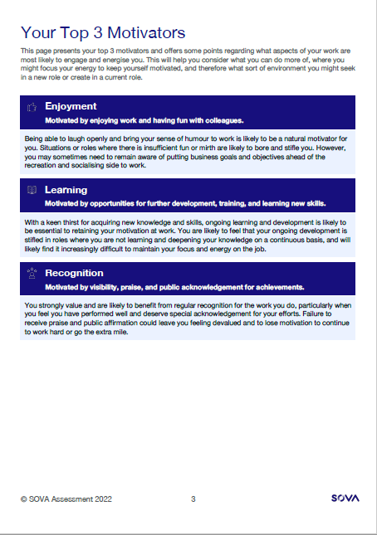
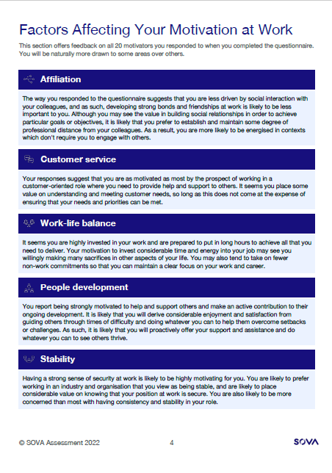
Candidate Report

Slide 21
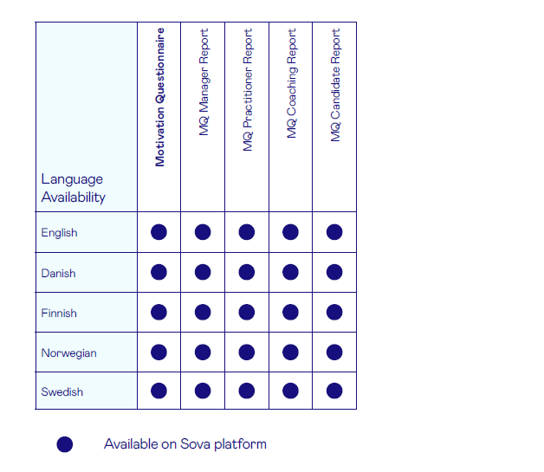
Language Availability

