Slide 1
Sova Assessment
Recruiting software powered by science
Two-way Video Interviews

Slide 2
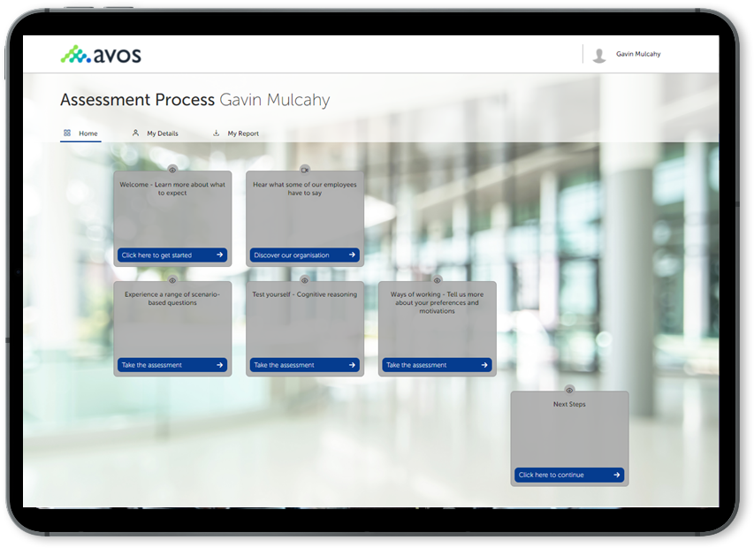
Candidate self-scheduling
The system can be configured to allow candidates to self-schedule e.g. candidates can pick from a list of available interview dates.

Slide 3

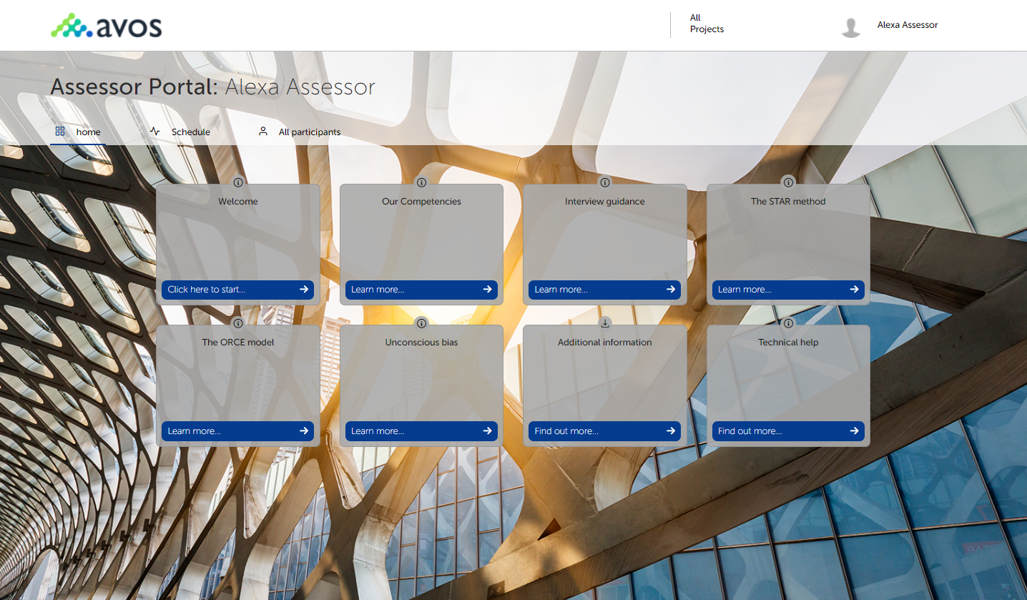
Assessor / Hiring Manager Homepage
Enable access to a range of content e.g.
Welcome text or video content
Briefing guides
Interview best practice materials
Unconscious bias information
Schedule an Interview only or an Interview plus other activities - role play, case study etc.
Use Sova embedded video for virtual delivery or integrate MS teams/Zoom etc. within the platform.

Slide 4
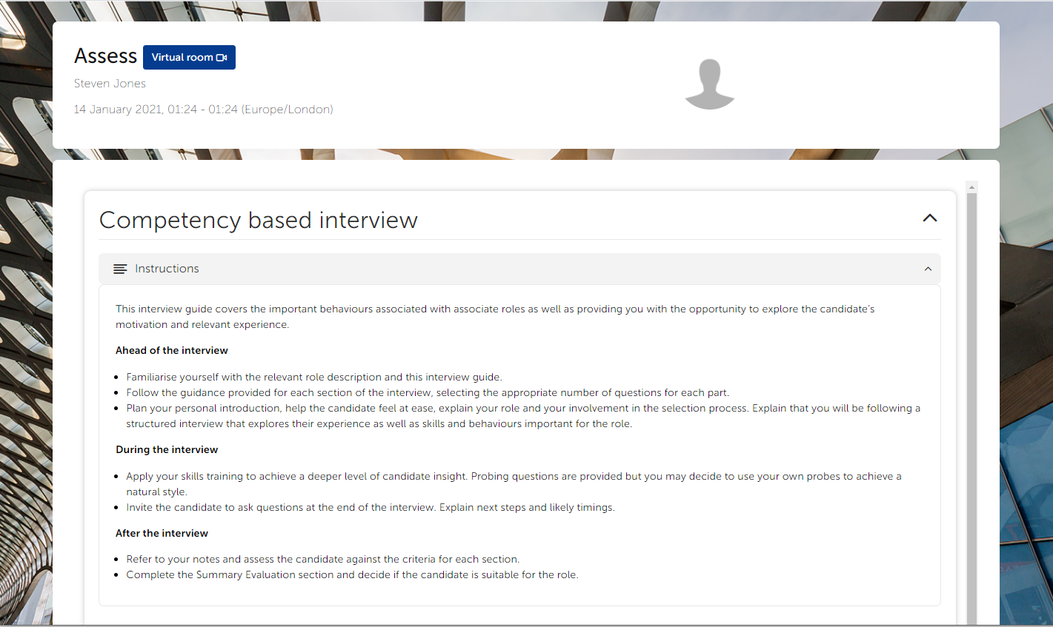
Interview Introduction

Slide 5
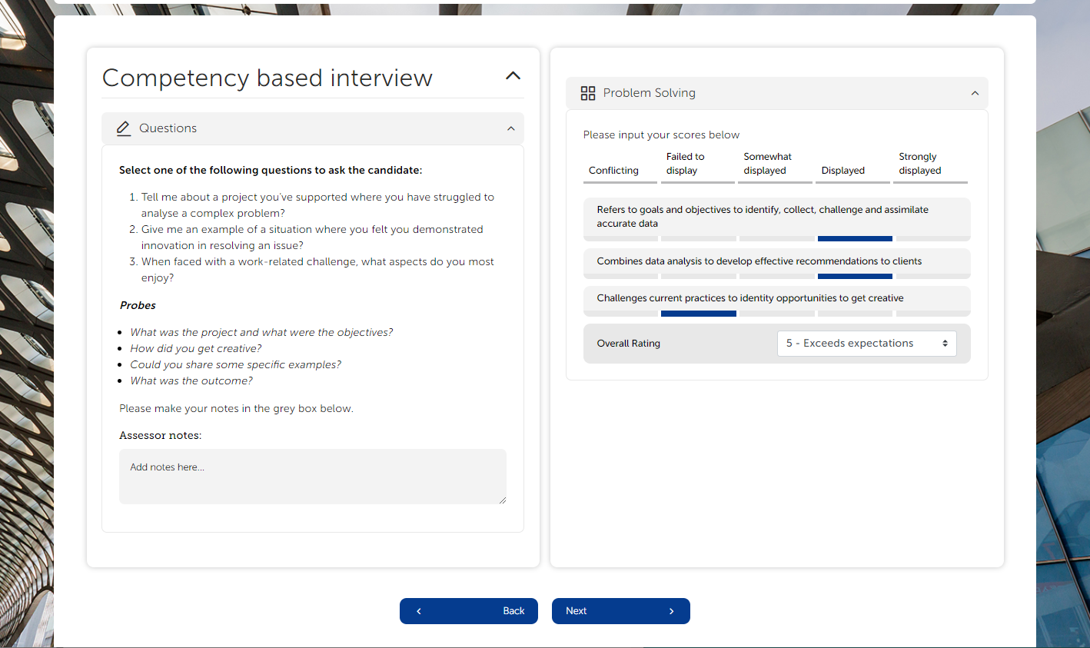
Interview Content, Notes & Data Capture

Slide 6
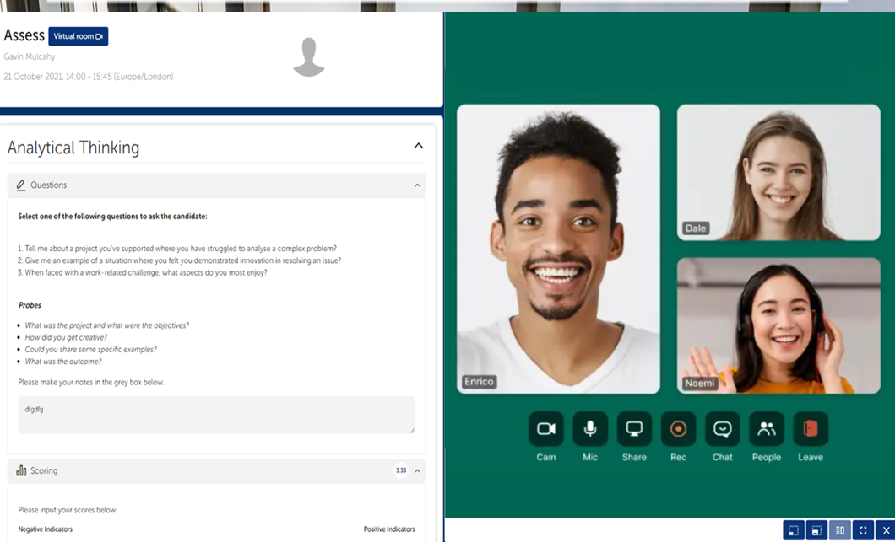
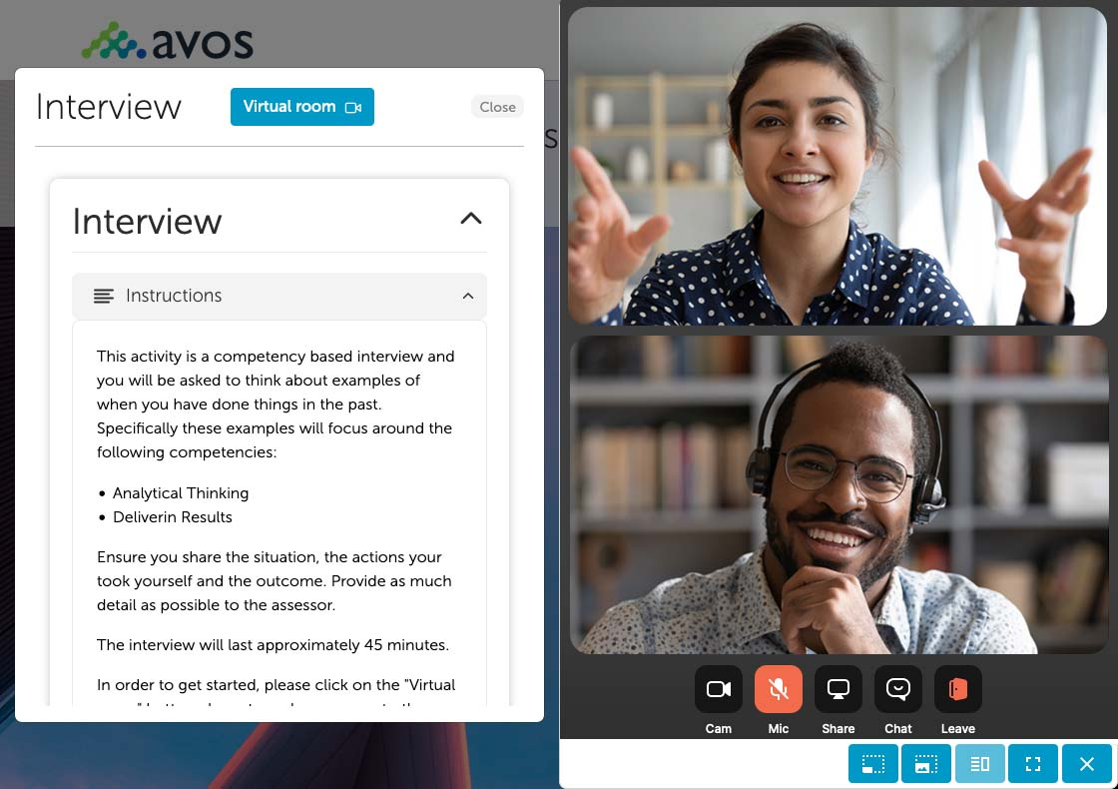
Embedded Live Video

Slide 7
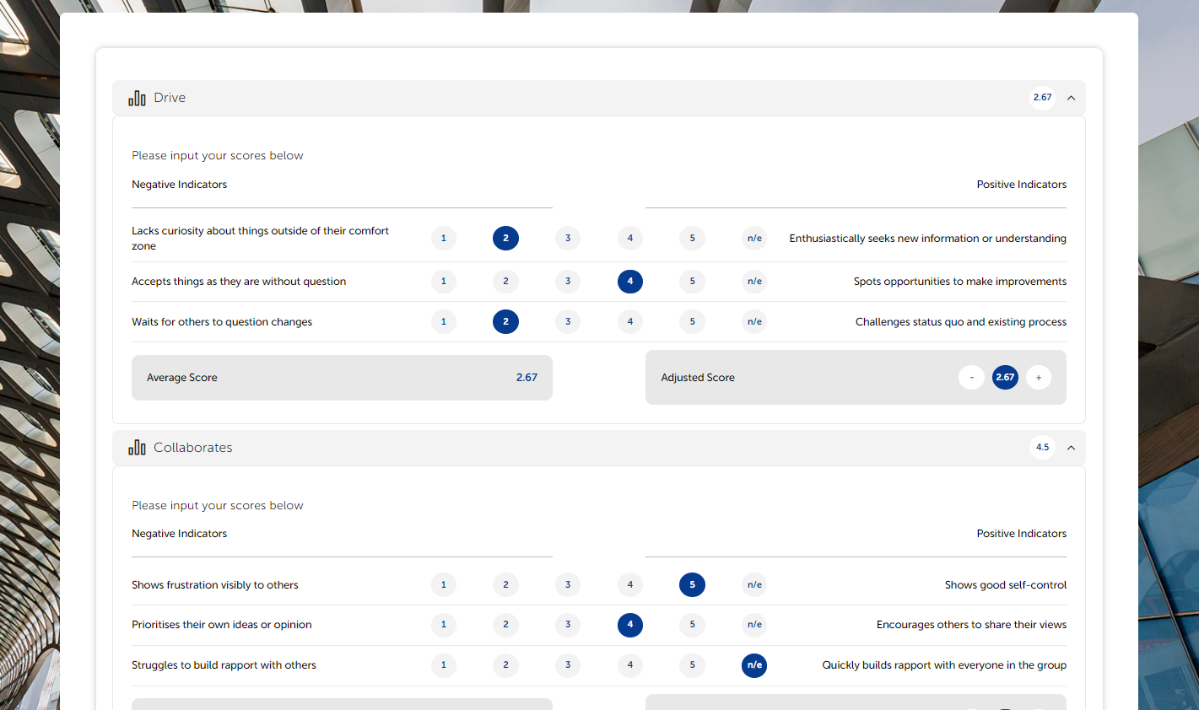
Interview Content, Notes & Data Capture

Slide 8
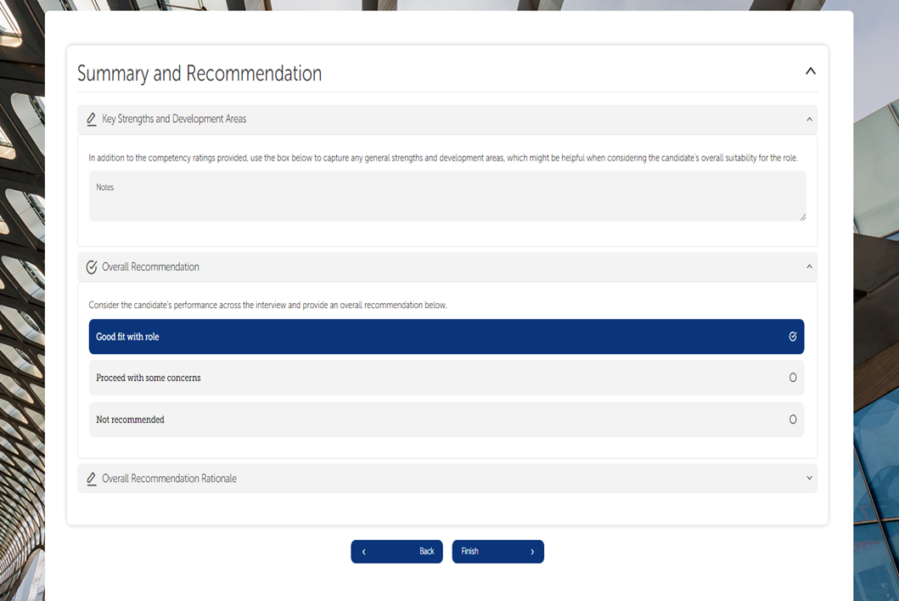
Interview Content, Notes & Data Capture

Slide 9
Leveraging Data Insights & Reporting

Slide 10
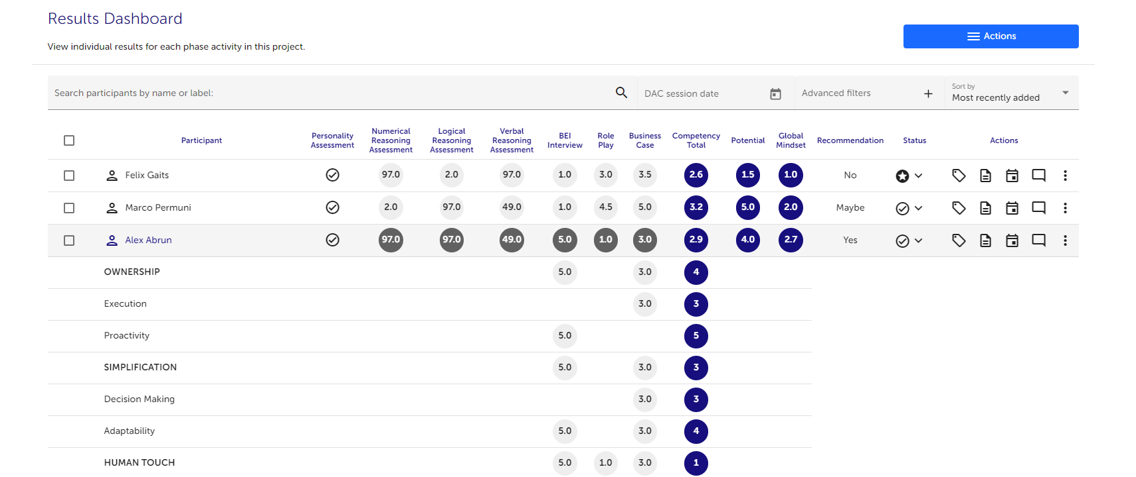
Online Data Dashboard

Slide 11
Project Dashboard
Our project dashboard provide a unified view of results including a project overview, completion rates, scores by individual at every stage of the assessment process and the ability to capture decision points at each phase of the journey.
Real-time data providing valuable insight to help our customers optimise their assessment processes.

