Slide 1
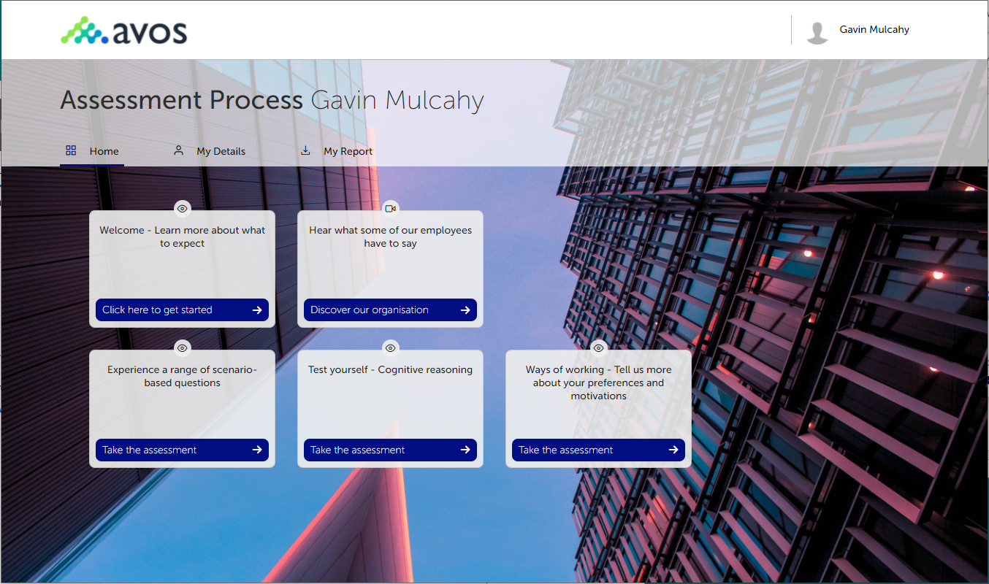
Candidate scheduling
From the candidate portal, candidates can pick from a list of available dates on when to schedule their assessment centre. Saving valuable time in administration of candidate availability.

