Slide 1
Sova Assessment
Recruiting software powered by science
One-way Video Interviews

Slide 2
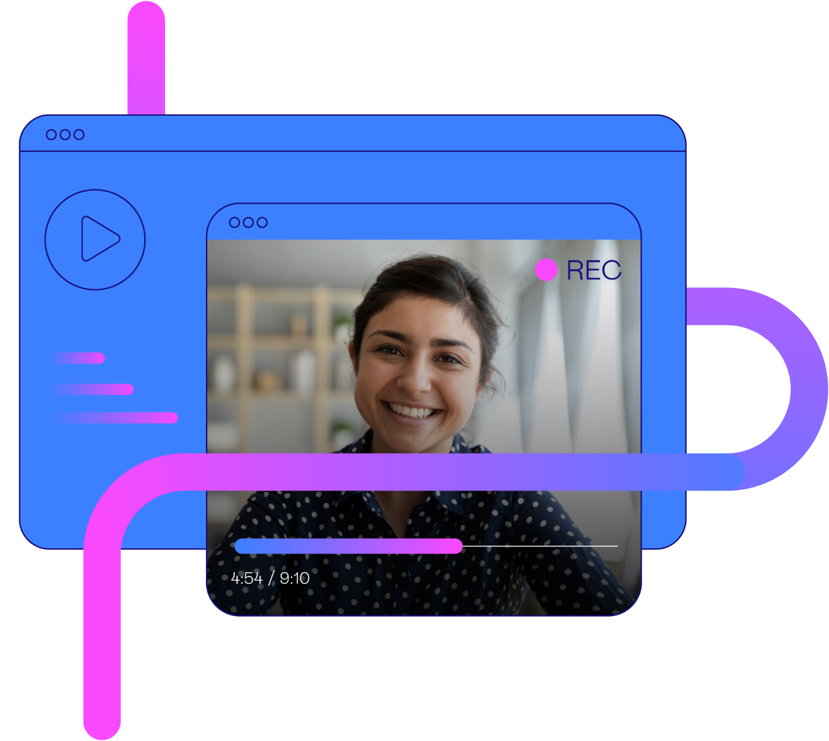
Candidate Experience
Web based, nothing to download, accessible on any device
Fully branded
Clear instructions – fully customisable
Users can add their own interview questions
Machine learning supports enhanced fairness and diversity when interviewing

Slide 3


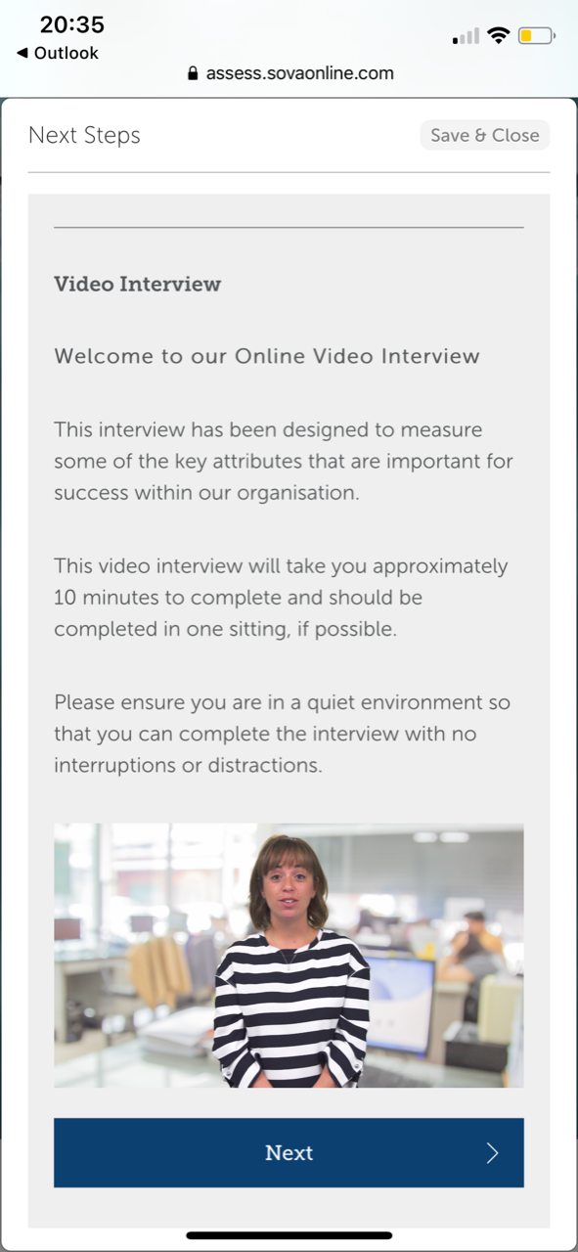
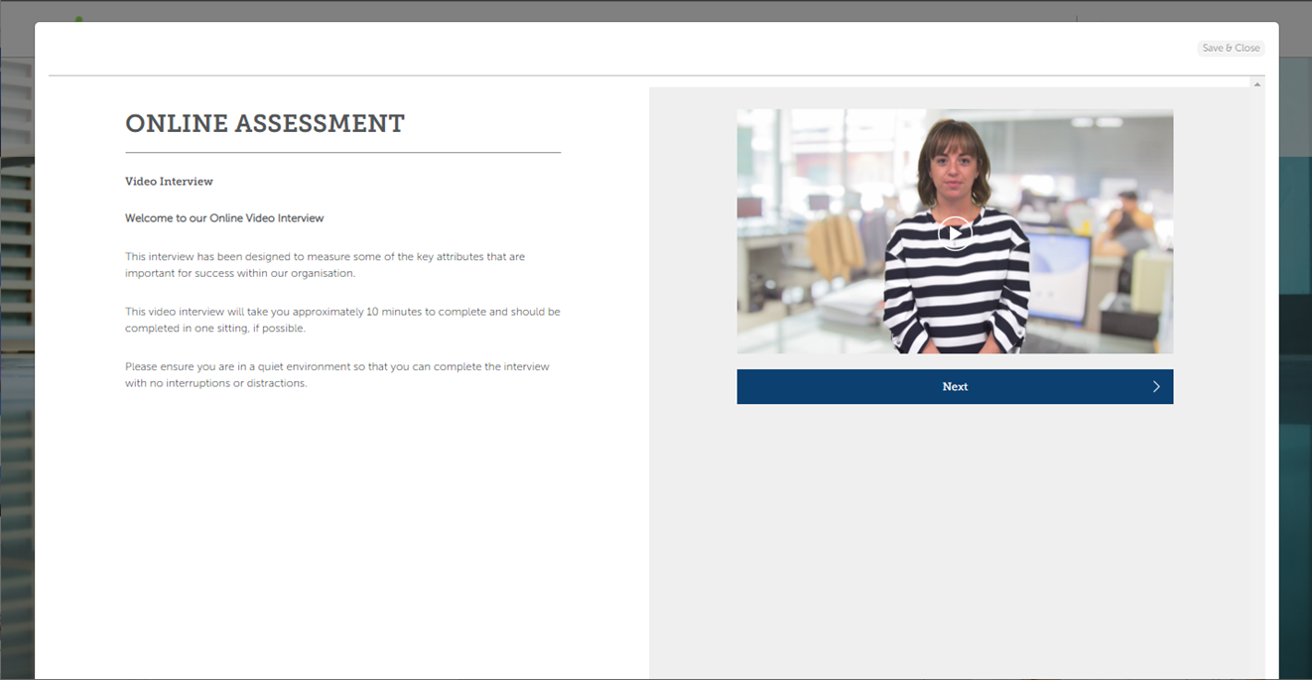
Candidate Experience - Welcome Pages
Customised welcome and instruction text.
Welcome videos can be added and candidates will have an opportunity to practice prior to starting the live questions.

Slide 4
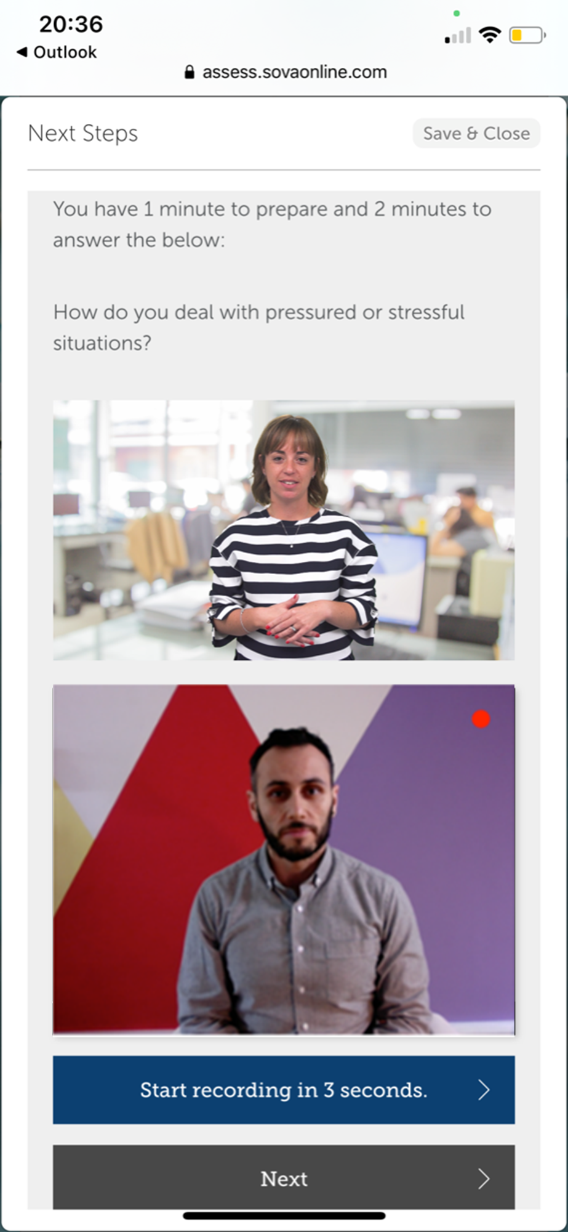
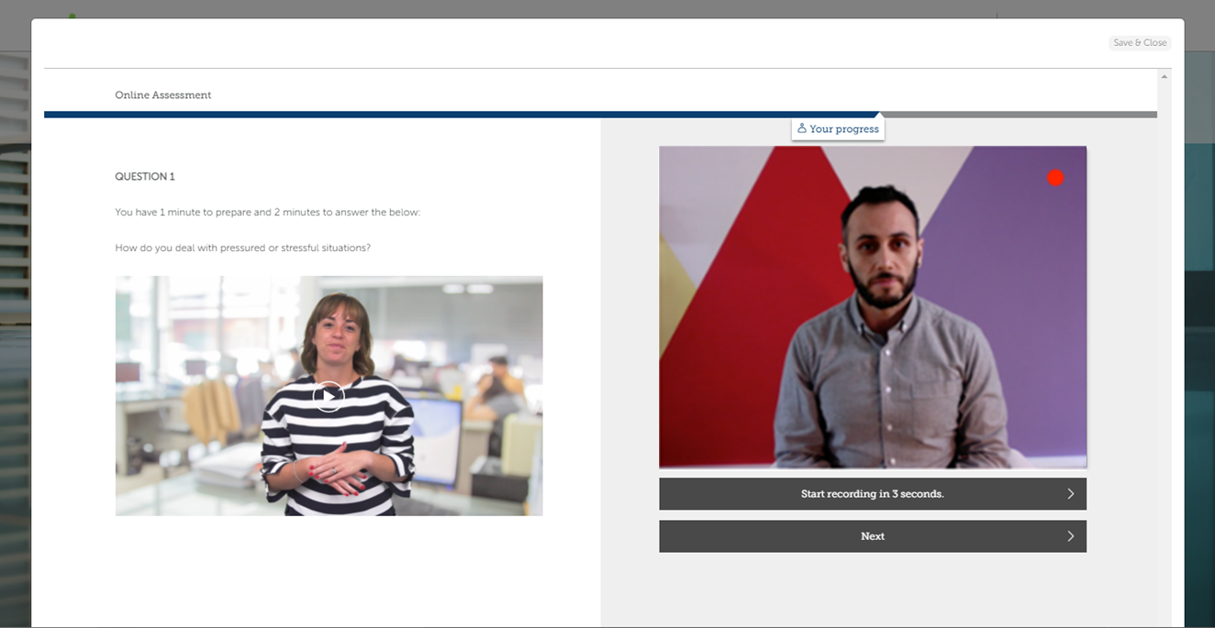
Candidate Experience – Questions & Responses
Questions can be presented in text or video format

Slide 5

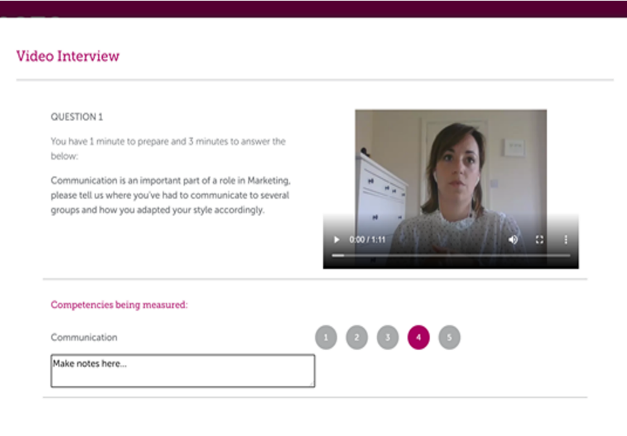
User Experience: Scoring Video Interviews
Accessed via Sova admin UI portal
Each question has a video response to
watch and score
Rating scale to apply score for
competency assessed
Notes box to capture relevant information
AI scoring – bespoke algorithm can be developed following sufficient data collection

Slide 6

The User Experience
Video interviews allow 1-way interviews to take place according to a set of pre-determined questions
Watch the interviews in your own time to score candidates using a pre-determined rating scale by competency/criteria assessed
Text or video-based interview questions
can be implemented
Set time limits on candidate thinking time and responses
Choose the rating scale you want to use
Add assessor scoring information if required
AI scoring reduces Recruiter time and enhances fairness in the interviewing process, when applied

Slide 7

One-way Video Interview Benefits
Improved efficiency:
  Significantly reducing time to hire by removing travel and the need to align diaries for a ‘live’ interview
  Reducing HR admin time to schedule live interviews
  Candidates and Assessors log into the platform at a time convenient to them
Improved Fairness:
  All candidates have a consistent experience
  No scope for hiring managers to ask different questions to candidates
  AI scored video interviews remove unconscious bias from the assessor scoring process
Improved Accuracy
  Improved accuracy and prediction in selection compares to traditional approaches
  Immediate reporting mapped to your competency framework
Improved
Efficiency
Improved Fairness
Improved Accuracy

Slide 8
AI in Video Interviewing
Notes:
Nic

Slide 9

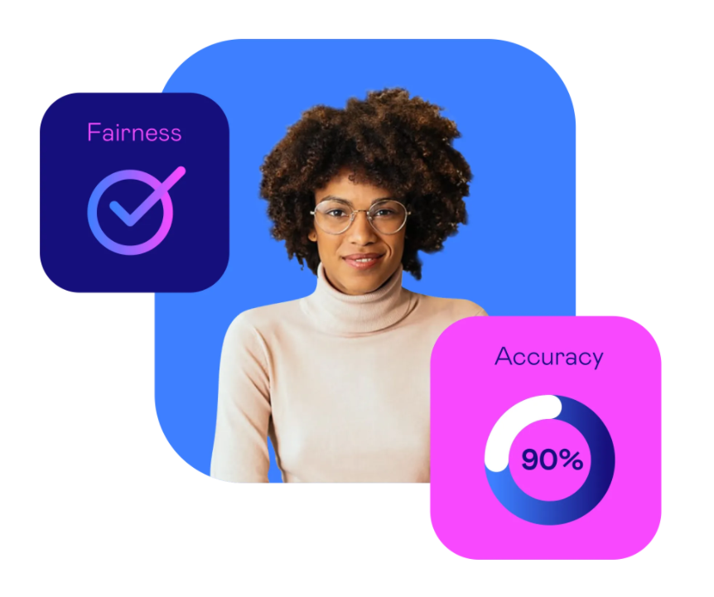

AI you can count on
We only apply AI to parts of our platform where we can do so in line with our core principles and where we know it adds value for clients and candidates. We commit to innovation without compromise on fairness or prediction
We only use proven AI in which
we’re fully confident. We use
nothing experimental. The tools
and scoring we use are
thoroughly tested
Selection becomes more accurate when the process is constantly optimised. We commit to continuously monitoring and improving the effectiveness and fairness of our AI assessment solutions

Slide 10

AI in Video Interviews
Sova’s automated video interview scoring uses ethically applied artificial intelligence (AI) to:
Improve video interview process efficiency
Helping hiring managers and recruiters
to shortlist candidates faster
Predictive decision-making
Decrease any potential bias

Slide 11
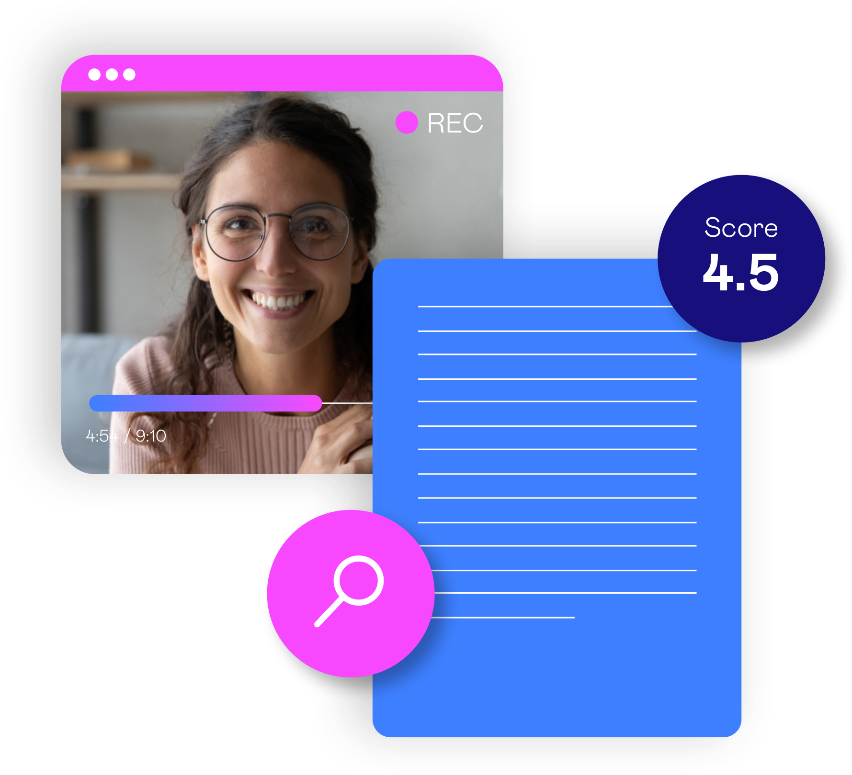
The Sova AI Scoring Algorithm
Each algorithm is unique; based on client
requirements (i.e. What do we want to predict?)
Video responses are converted to text
The text is analysed, with a focus on verbal
information (i.e. What is said). For example,
we analyse language pattern, word choice
and sentiment
We do not use facial analysis or any other
information that might cause bias
The algorithm and score generation doesn’t
replace the human element but helps to
re-focus that effort onto top candidates

Slide 12
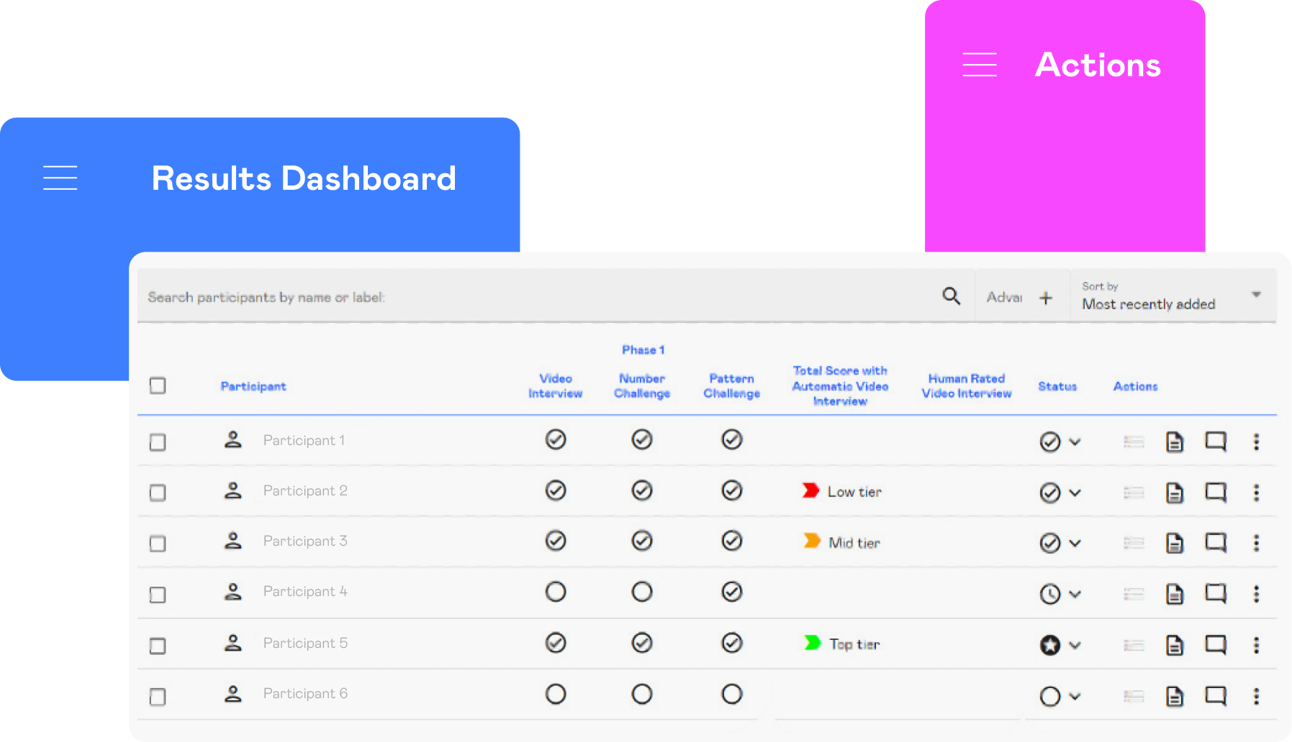
Data Dashboard (AI Scored)
Recruiters and Hiring Managers can view the Automatic Video Interview Score in the dashboard
This is typically graded as high/med/low for ease of use in sifting, helping to prioritise effort for Recruiters
Candidates in the High band are deemed most suitable for the role so these candidates are reviewed first by recruiters. Should more candidates be needed to fill places, recruiters can progress to the Mid band.
The original video can be accessed and
re-scored by a Recruiter or Hiring Manager if needed

Slide 13
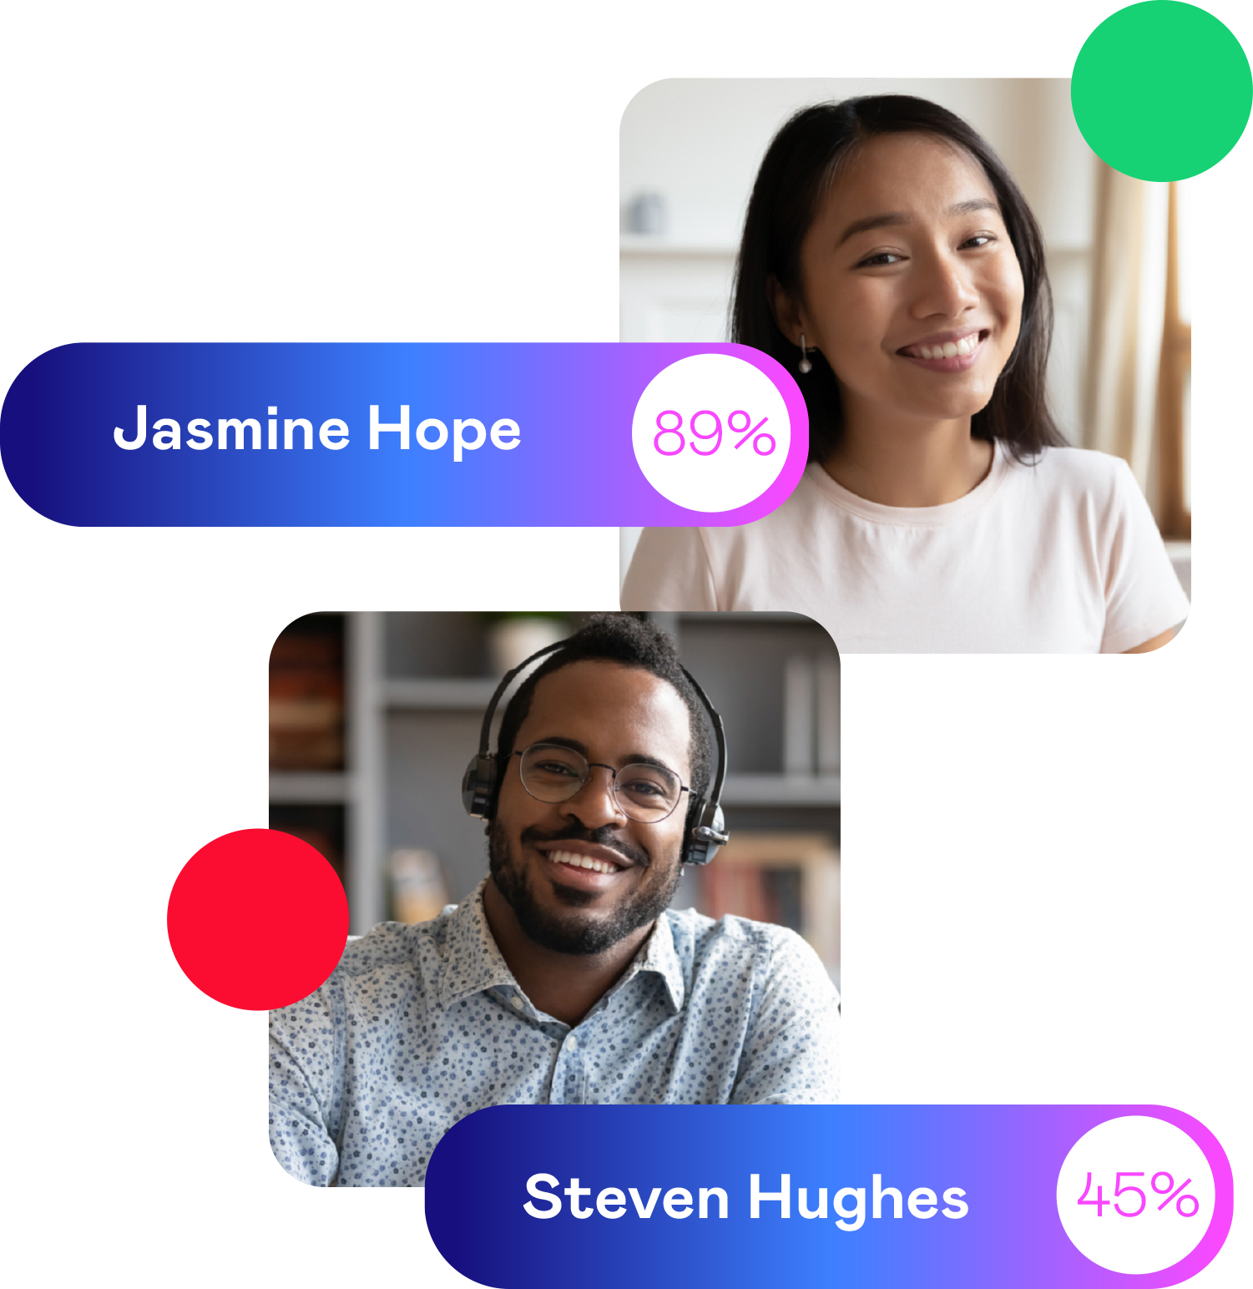
Score Output
One overall score is produced
There are no competency scores or scores from each interview question. This benefits recruiters by taking away the need to reconcile multiple ratings into one
Score output usually is in Red / Amber / Green (RAG format).
Whereby ‘green’ candidates have the highest scores (although colours are configurable and 1-5 bands can be defined)
Typically, recruiters will wish to review the High band video
interviews to confirm whether each candidate should move
to the next stage
The banding system helps recruiters and hiring managers to
prioritise their effort and resource. For example, this can
save recruiters two-thirds of the time they might otherwise
have spent reviewing all the video interviews
We commit to monitoring and adjusting score bands, if required

Slide 14
Key Steps in AI Algorithm Development
Step 1
Step 2
Step 3
Step 4
Step 5
Interview
Data
Human Scored
Data
Algorithm
Modelling
Algorithm
Sense-Check
Algorithm Validation
c.1000 existing
1-way video interviews are transcribed to text and split into two: training and test data
Match interview data to outcome measure and demographic data. The outcome measure is what we’re trying to predict (this might be interview scores from an assessor or Assessment Centre Scores or job performance data
A number of predictive algorithms are modelled based on verbal information from the interview and their relationship with the outcome measure (and group differences)
Algorithms are compared and reviewed by SMEs. Checked for levels of prediction and fairness
The algorithm is applied to the test dataset to confirm its predictiveness and fairness

Slide 15
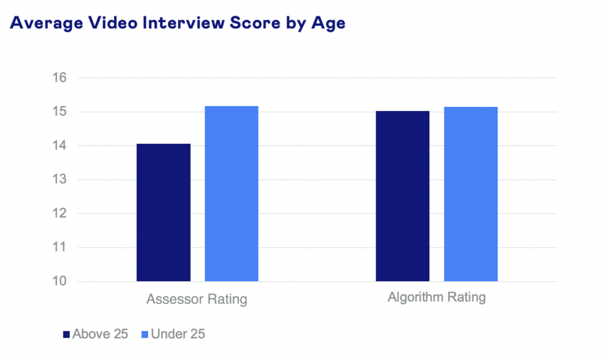
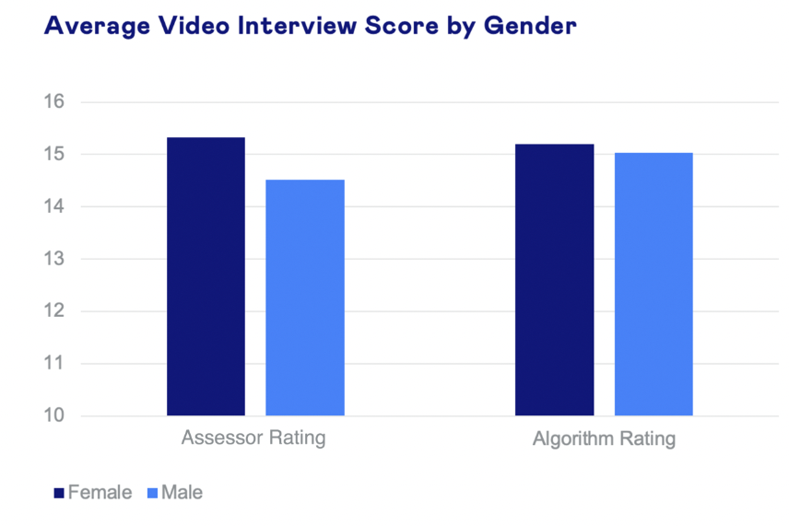
Fairness
With one client study, we have seen reduced bias compared to assessor ratings of video interviews. The charts illustrate that score differences between gender and age were much smaller in algorithm-based ratings, when compared with assessor ratings
© 2023 Sova Assessments

Slide 16
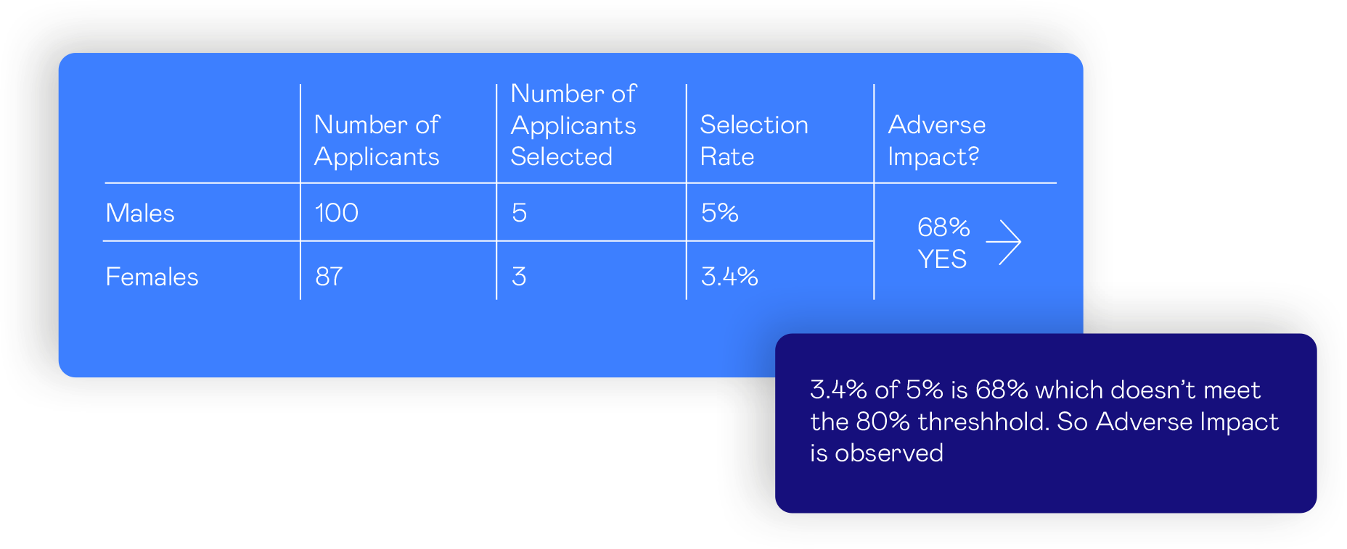
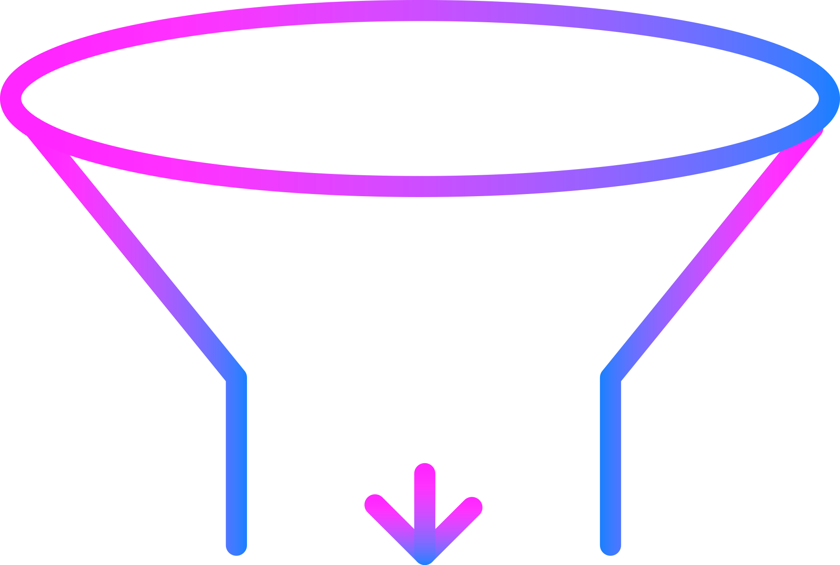

The 4/5^{ths} Rule Explained
The 4/5^{ths} (or 80%) rule is a commonly used industry standard to evaluate the fairness of a selection procedure. The rule states that the pass rate for any one group should always be at least 80% of that of the group with the highest pass rate (and ideally as close to identical (100%) between groups).
Females
Males
Pass Selection

Slide 17

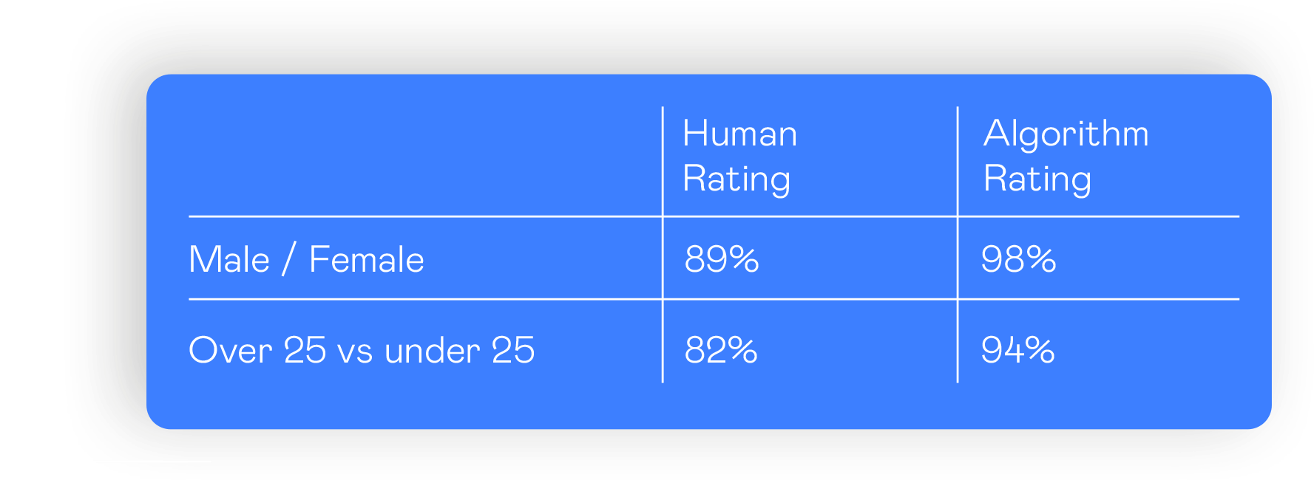
Fairness
Using the 4/5ths rule to check for Adverse Impact and evaluate
fairness, we did not find any adverse impact (from one client case). This is when using the 30th %tile as the ‘cut-score’ to screen out the bottom
30% of candidates.
Interestingly, with human ratings, male candidates
pass 89% as often as females and over 25-year-olds
pass 82% as often as under 25s. These figures
are still within the 4/5ths rule, but noticeably lower
than the fairness delivered by the algorithm.

Slide 18

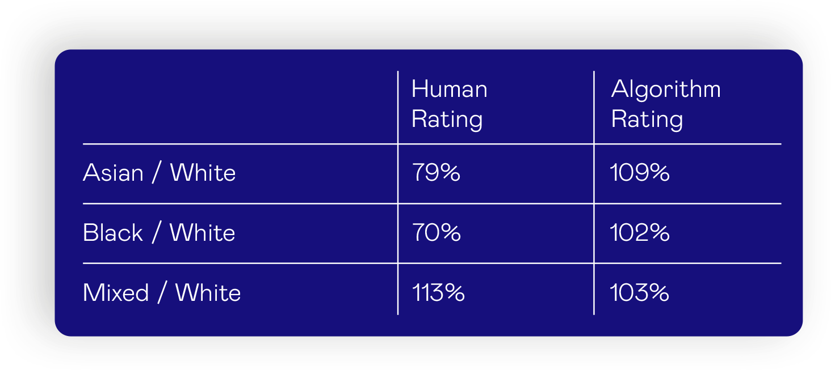
Fairness
Using an alternative client’s data set, we were also able to
demonstrate an improvement when considering ethnicity
(this was set at the 50the %ile sifting rate):
Here, we can see that, with human ratings, Asian
candidates pass 79% as often as White candidates
(which doesn’t meet the adverse impact threshold)
but with the algorithm, Asian candidates are more
likely to pass than White candidates.

Slide 19
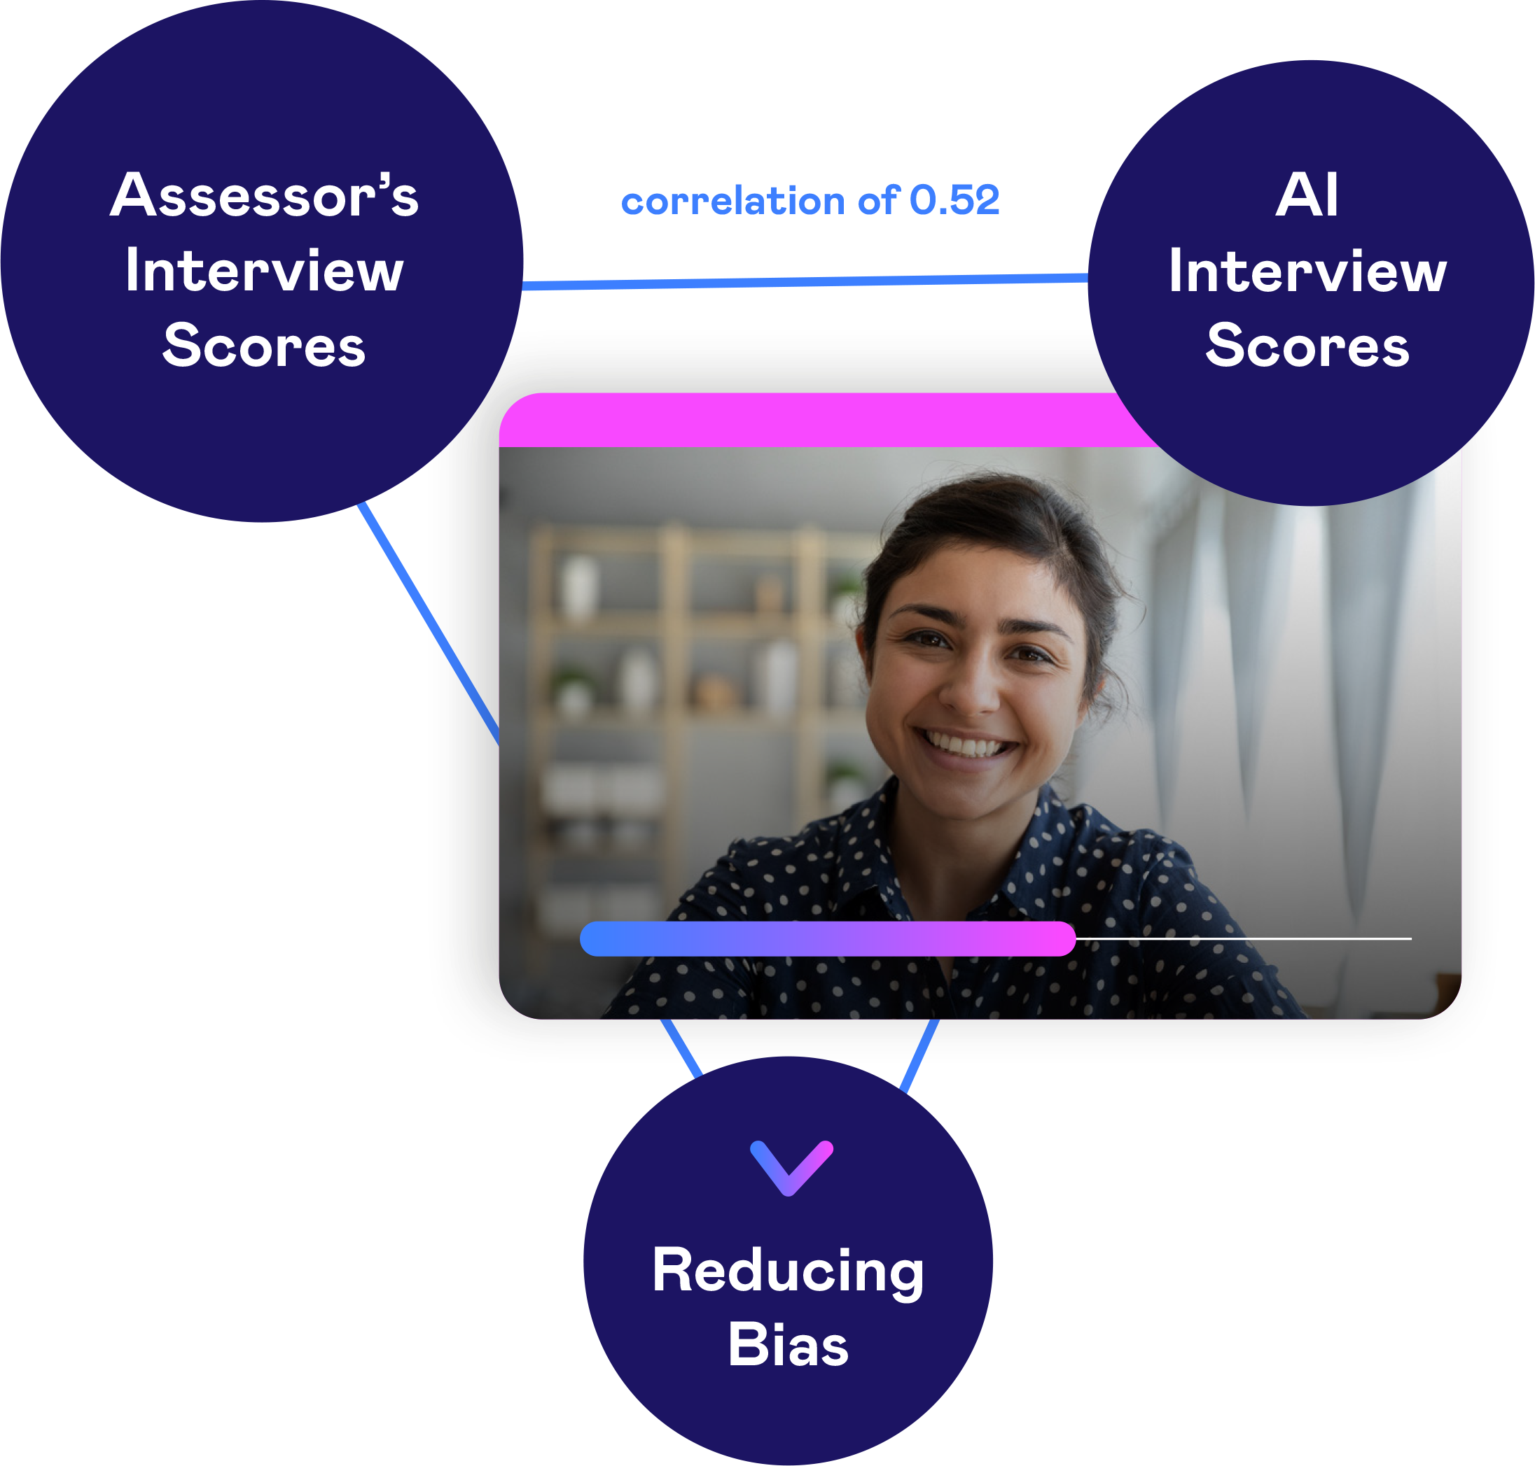
Accuracy
Scores from the AI algorithm are highly correlated with assessor ratings, demonstrating the AI assessment of video interviews is very effective at assessing candidates accurately.
With one client study, we found a correlation of 0.52 between assessor’s interview scores and AI interview scores.

Slide 20
Automated Video Interview Scoring Benefits
Improved efficiency:
  Significantly reducing recruiter time by two-thirds or more, by automatically scoring and ranking video interviews
  Through objective analysis of the video interviews via the AI scoring tool, significantly increasing the pass
  rate at the final stage
  Reduce the number of assessment centres needed
  to make the required number of hires
Diversity, inclusion and equity: The rigorously tested algorithm leads to a fairer outcome than relying on human judgment alone, significantly improving the diversity of candidates
Quality of hire: Through use of the AI video interview, the predictiveness of the assessment is enhanced leading to high performing hires that benefit the business
Improved
Efficiency
Diversity,
Inclusion and
Equity
Quality
Of Hire

Slide 21
Configuration Features
No limitation on number of questions / duration
Time allowed to read the question and record a response is configurable on a per question basis
Text and video-based questions can be added
Practice section for candidates to prepare and get comfortable with the technology
The ability to re-record can be enabled or disabled on a per question basis
Allow for different questions sets for different recruitment steams
Questions can be configured to correspond with specific competencies
Quick to update content and users can add their own interview questions if preferred
Automatic reminders can be sent to the candidate x hours before deadline
Configured as a standalone interview stage or combined with other online psychometric assessments

