Slide 1
Sova Assessment
Our Assessments

Slide 2

Workplace Psychological Test validity
is comparable to Medical Test validity
Work Samples
0.54
Cognitive Ability
0.51
Structured Interviews
0.51
Job Knowledge Tests
0.48
Behavioural Questions
0.45
Unstructured Interviews
0.38
0.38
Accuracy of home pregnancy tests
Assessment Centres
0.37
0.30
Sleeping pills & improved insomnia
Reference Checks
0.26
Job Experience
0.18
0.18
Nicotine patch & smoking abstinence
0.14
Ibuprofen & pain reduction
Years of Education
0.10
0.02
Asprin & reduced risk of heart attack
-0.01
Age
Schmidt & Hunter (1998), Meyer et al. (2001)

Slide 3
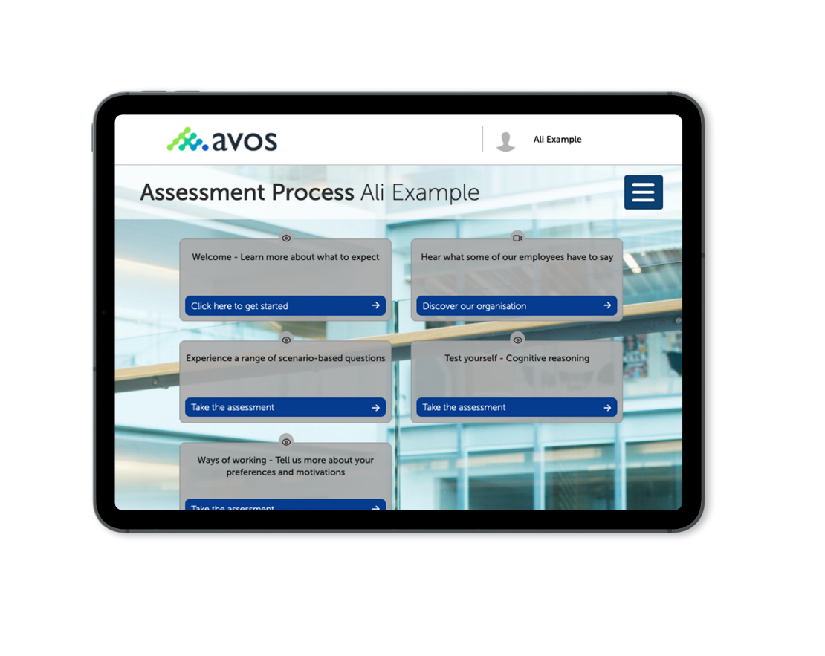
Candidate interface
An interactive homepage where candidate
can access different activities by clicking
hotspots, for example:
Take assessments
Take a video interview
Start your AC pre-work
Welcome video
Include information
Upload a CV or other info
Complete an exercise
Use of multi-media creates an engaging experience. This allows candidates to select areas to complete in their own time.
Notes:
https://assess.sovaonline.com/hub/?ar=eNoBoABf_0Bjj8N0sD2nEYjEN13gaJTWo7rhdFhwOLtvfmfOH9VqSjtfvE6-Nh5C9kTwuXCOzs61xwg4zKTfdzsyl4x93piC3pOfKUxVrwOjqmbr5ByvAKxYYmghp7E2q4iDKL_fsqUtPLMHOZ9Q27_lF8KnLJURpyLIdMs1k870_ZUF3dOBGSagt45Hux7BAI9hAz-KQiK68V_zPBvHAz4beKEjho2Ysk8m
This is a sample of our interactive candidate homepage where the candidate can access a range of different activities by clicking on hotspots, including taking assessments, video interviews, completing pre-AC work, viewing welcome materials and messages, they can upload information such as a CV and supporting documentation and complex an assessment. These can be set-up to release to the candidate at different points in their assessment process, providing clients with complete control over what is accessed and when.

Slide 4
Off-the-shelf vs. bespoke solutions
Off the shelf
Customised
Personality
Questionnaire
Adaptive
Ability Tests
SJT’s
Client specific ability items
Configuration
Motivation
Questionnaire
Contact Centre
Assessment
Do it yourself
Blended assessments
Client content
Gamified assessments
Graduate SJT*
Use Sova’s services
Virtual Assessment Centre
Video Interview
Skills assessments through integration
Learnability Assessment*
Leadership Agilty**
3rd Party Assessments
*Requires client validation, **Requires specific training

Slide 5
Personality
Questionnaire

Slide 6
Sova Personality Questionnaire (PQ)
Focuses on behavioural preferences at work
Is quick to complete – an average of 25 minutes
per completion. Contains 160 questions in total
(40 blocks)
A range of standard SOVA reports – Derailment,
Development, Team styles etc
Can be mapped at a granular item level to your
competency framework
  Questionnaire format
  Quad statements (4 statements)
  with a most and Least response
  scale
  160 questions (40 blocks of 4 statements)
  Forced Choice – ratings cannot
  be ‘tied’. This approach to provides
  a more granular insight into
  behavioural preferences, minimise
  faking good and central tendency.
  - Minimises acquiescence via a mix
  of positively and negatively
  worded statements

Slide 7
HEXACO personality model
Also described as ‘Big-5 plus’, HEXACO
consists of 18 traits and 54 ‘sub-traits’ and
underpins SOVA’s personality assessment
Extensive research indicates a wider
cross-cultural applicability than the
Big-5 alone
Provides helpful insight when measuring
potential derailment behaviours in high
pressure situations

Slide 8
Sova Personality Questionnaire (PQ)
 | HEXACO / Trait | Sub-trait 1 | Sub-trait 2 | Sub-trait 3
H | Straightforward | Adhering to rules | Candid | Straightforward
H Status Avoidance | Status Avoidance | Egalitarian | Collective | Status avoidance
H Modesty | Modesty | Humble | Modest | Avoiding attention
E | Resilience | Tough minded | Recovering | Optimistic
E Emotional Control | Emotional Control | Controlling stress | Calm | Composed
E Independence | Independence | Self-reliant | Self-contained | Independent minded
X | Connecting | Open communication | Building networks | Initiating contact
X Dynamic | Dynamic | Enthusiastic | Energetic | Risk appetite
X Influential | Influential | Influencing | Desire to lead | Assertive
A | Cooperative | Sensitivity | Teamwork | Agreeableness
A Empathy | Empathy | Empathy | Listening | Warmth
A Supporting | Supporting | Developing others | Helpfulness | Thoughtfulness
C | Goal-focused | Competitive | Challenge | Self-discipline
C Organised | Organised | Planning and organising | Attention to detail | Keeping promises
C Analytical | Analytical | Data focus | Evaluating | Analytical
O | Complex Thinking | Strategic thinking | Conceptual | Curiosity
O Creativity | Creativity | Innovating | Generating ideas | Experimenting
O Adaptability | Adaptability | Adapting | Flexible | Variety

Slide 9
Measuring what you need
Easy to map onto the XXXX framework for custom reporting
 | HEXACO / Trait | Sub-trait 1 | Sub-trait 2 | Sub-trait 3
H | Straightforward | Adhering to rules | Candid | Straightforward
H Status Avoidance | Status Avoidance | Egalitarian | Collective | Status avoidance
H Modesty | Modesty | Humble | Modest | Avoiding attention
E | Resilience | Tough minded | Recovering | Optimistic
E Emotional Control | Emotional Control | Controlling stress | Calm | Composed
E Independence | Independence | Self-reliant | Self-contained | Independent minded
X | Connecting | Open communication | Building networks | Initiating contact
X Dynamic | Dynamic | Enthusiastic | Energetic | Risk appetite
X Influential | Influential | Influencing | Desire to lead | Assertive
A | Cooperative | Sensitivity | Teamwork | Agreeableness
A Empathy | Empathy | Empathy | Listening | Warmth
A Supporting | Supporting | Developing others | Helpfulness | Thoughtfulness
C | Goal-focused | Competitive | Challenge | Self-discipline
C Organised | Organised | Planning and organising | Attention to detail | Keeping promises
C Analytical | Analytical | Data focus | Evaluating | Analytical
O | Complex Thinking | Strategic thinking | Conceptual | Curiosity
O Creativity | Creativity | Innovating | Generating ideas | Experimenting
O Adaptability | Adaptability | Adapting | Flexible | Variety
Mapping sub-traits
onto the XXXXX competencies
and values

Slide 10
Test Reliability and Norms
  Age (%)
  27
  35
Through our ongoing research programme,
we will consider and examine test reliability
in different ways.
We examine internal consistency to gauge
how well our assessments measure what we intend them to.
We use Cronbach’s alpha coefficient, calculated using classical test theory, which operates on a 0 to 1 scale. The typical industry acceptable level for this coefficient is 0.7.
Our average reliability co-efficient is 0.8
Our Norm (n=4,500) is a general population
of mixed biographical make-up
  9
  12
  17
  Under 30
  31 to 40
  41 to 50
  51 and over
  Not available
  Gender (%)
  27
  40
  33
  Male
  Female
  Not available

Slide 11
Adaptive Ability
Assessments

Slide 12
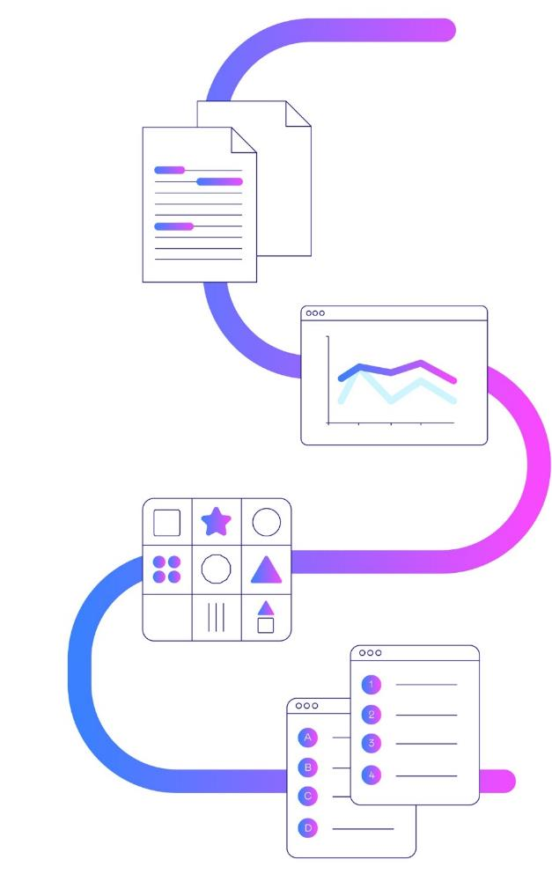
Measuring cognitive ability
Verbal reasoning tests
Assessing how quickly and accurately candidates can interpret and process written information.
Numerical Reasoning tests
Assessing a candidate’s ability to work through, interpret and analyse numerical data.
Logical reasoning tests
Assessing how a candidate can process abstract information, such as identifying patterns in a sequence.
Checking Skills
Assessing how quickly and accurately the candidate can work with information by checking data in a speedy manner.
Each assessment takes approx. 15 minutes to complete – time recorded but not time limited

Slide 13
Adaptive branching technique
Q
Q
Q
Q
Q
Q
Q
Q
Q
Q
Q
Q
Q
Q
Q
Q
Q
Q
Adaptive ability branching
Based on response to the question, subsequent questions either increase or decrease in difficulty, quickly getting to the candidate’s ability level.
Q
Q
Q
Q
Q
Q
Q
Q
Q
Q
Q
Q
Q
Q
Q
Q
Q
Q
Q
Q
Q
Q
Q
Q
Content security
Each candidates journey through the assessment is different. The shelf life of content is extended
Q
Q
Q
Q
Q
Q
Q
Q
Candidate A
Candidate B

Slide 14
Measuring cognitive ability
Verbal reasoning tests
This test assesses how quickly and accurately the candidate can process novel verbal information and use it to draw
the correct conclusions. This type of reasoning ability is involved in tasks that require making sense of large amounts
of written information, such as interpreting written reports or documents.
Numerical Reasoning tests
This test assesses how quickly and accurately the candidate can process novel numerical information and use this
to calculate the answer to the question. This type of reasoning ability is involved in tasks that require analysis and
interpretation of numerical data, such as working with graphs or budgets, or carrying out various calculations.
Logical reasoning tests
This test assesses how quickly and accurately the candidate can process novel abstract information, such as
identifying patterns in a sequence. This type of reasoning ability is involved in tasks that involve more abstract
information or data, such as in IT programming or the sciences.
Checking Skills
This test assesses how quickly and accurately the candidate can work with information by checking data in a
speedy manner. It is a measure of attention to detail, accuracy and methodical working.
Each assessment takes approx. 15 minutes to complete – time recorded but not time limited

Slide 15

Providing diversity and fairness
We believe that timed ability tests make an assessment process unfair to some groups of people
A count-down clock for each answer (or each test) does
not bring out optimum performance in candidates
Candidates feel stressed, cheated and nervous about tests which prevent adequate thinking time through ‘timing-out’
Some groups (by gender, age, or ethnicity) notably perform significantly lower on tests with count down timers
Our ability tests do not contain an on-screen timer.
Our tests are time-recorded behind the scenes (which
forms part of the scoring rules) but there is no time limit on completions and no count down timer
This method promotes candidate diversity (including neurodiversity) completions in a fair way

Slide 16
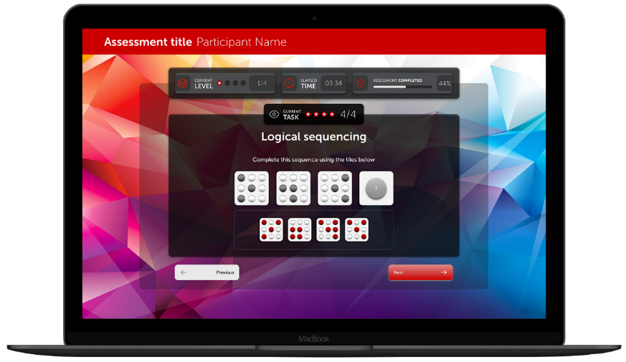
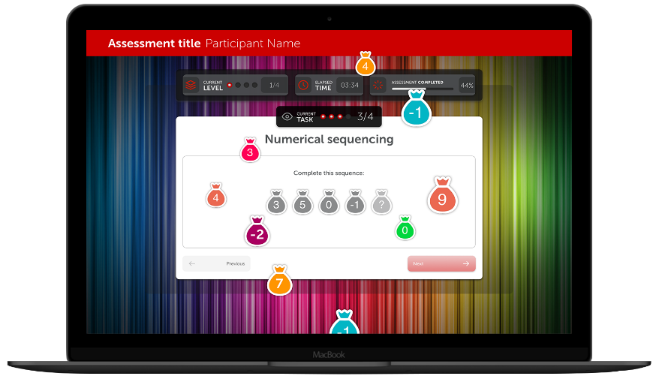
Gamified Assessment
Coming in 2021 - New Gamified assessments.
Ideal for Early Career roles and frontline roles:
Numerical
Logical

Slide 17
Motivation
Questionnaire

Slide 18
Why Measure Motivation?
Having meaningful work has been shown to play key role in …
Discretionary Effort
Performance
Job
Satisfaction
Retention
Employee Engagement

Slide 19
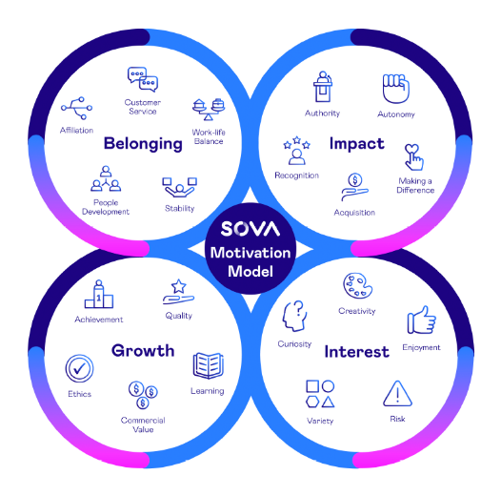
Sova’s Motivation Questionnaire
Measures the key factors that stimulate and energise people in the workplace.
Four reports are available:
  Practitioner Report – profile chart of scores on all 20 scales, general overview of their scores, implication of the key motivators and their ideal/least ideal work environment.
  Manager Report – How to work with and manage this individual and how their motivators affect their relationships at work.
  Coaching Report – profile chart of scores on all 20 scales, upsides and downsides of key motivators and suitable coaching questions.
  Candidate Report – ‘your top 3 motivators’ and overview of the scores on all 20 scales.

Slide 20
Motivation and Personality
What are people’s behavioural preferences?
Reflect someone’s preferred ways
of behaving, thinking and feeling
Personality assessments
What drives people to behave in certain ways?
Reflects underlying needs, aspirations
and goals plus what is needed in order to feel that work is meaningful
Motivation assessments

Slide 21
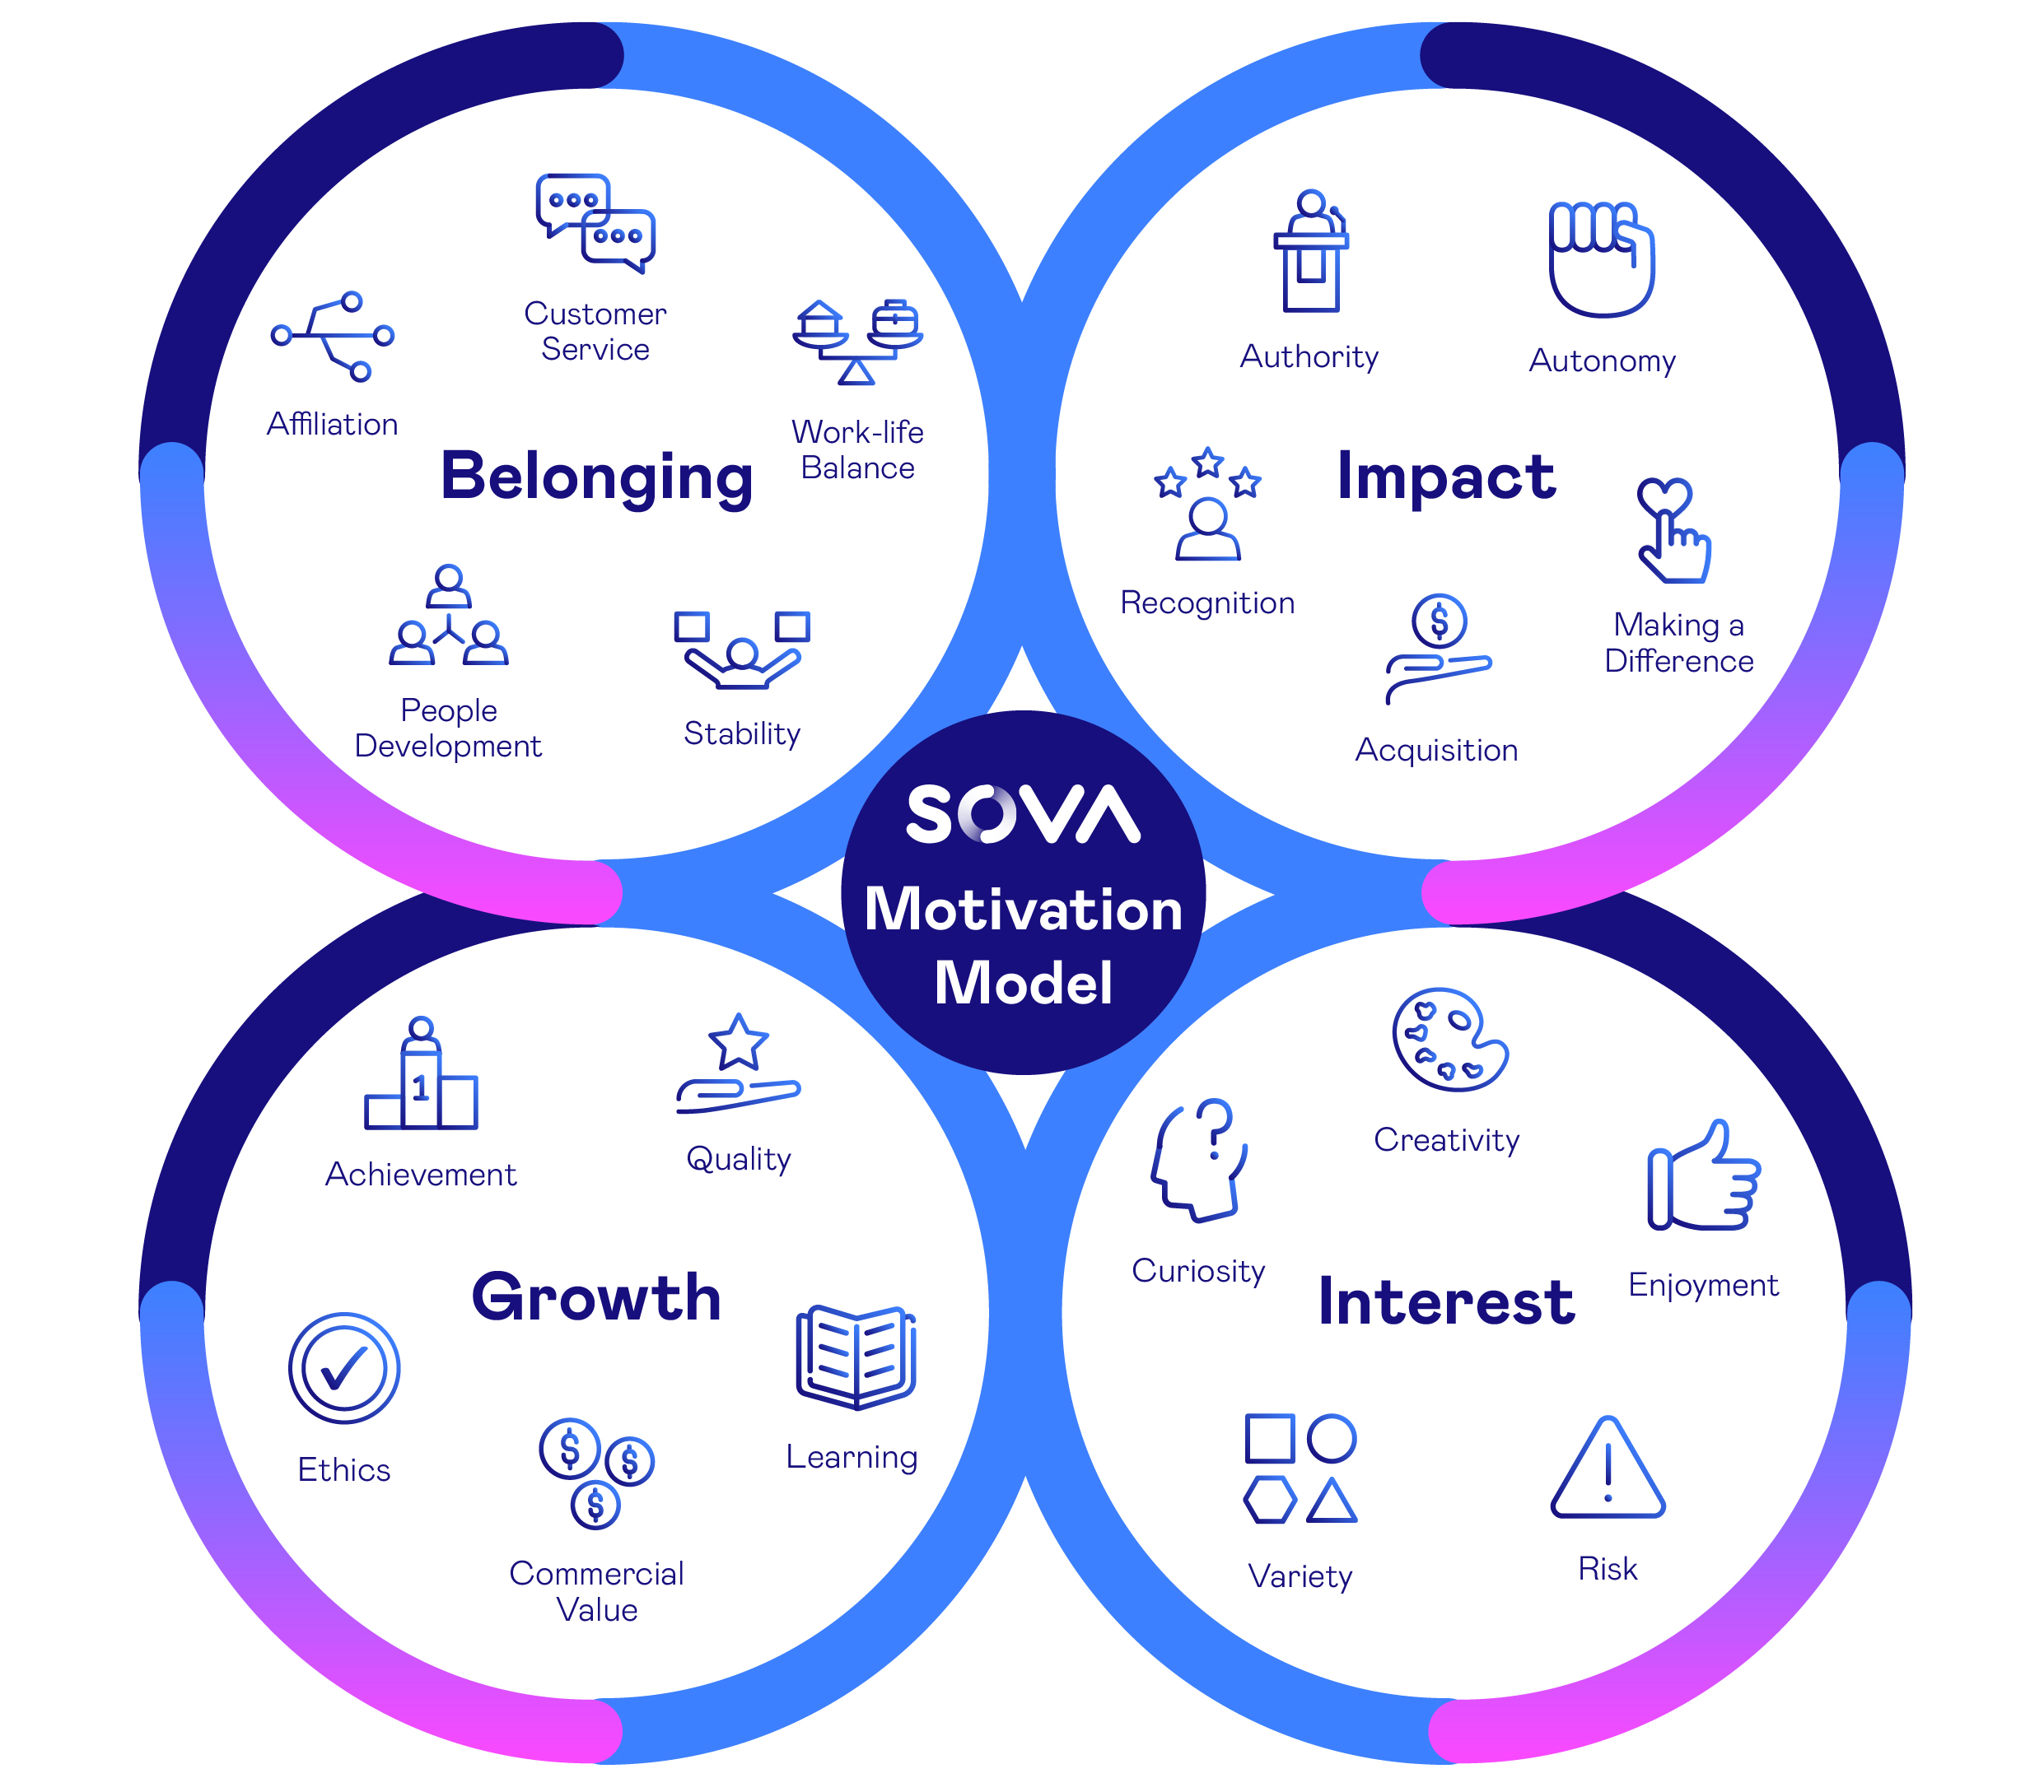
Sova’s Motivation Model
Sources of connection
and sense of community
Sources of self-value and sense of worth
Sources of personal
challenge and sense of
triumph
Sources of personal satisfaction and sense of immersion

Slide 22
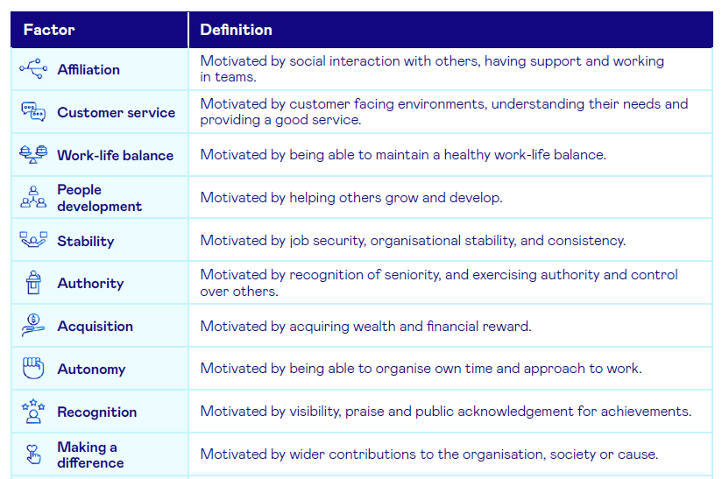
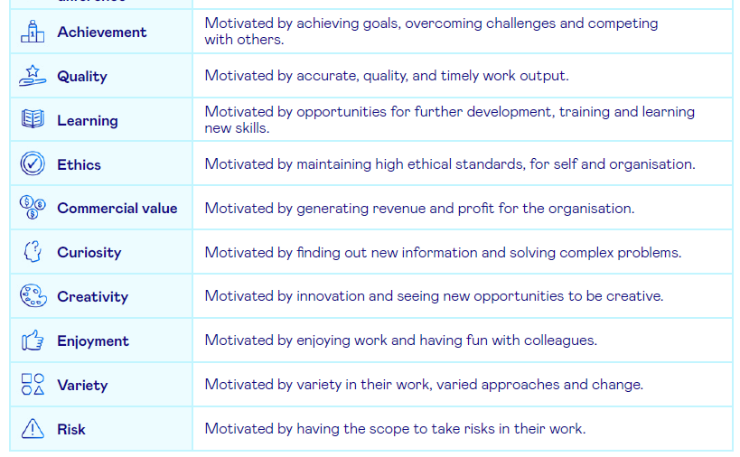
The 20 Factors

Slide 23
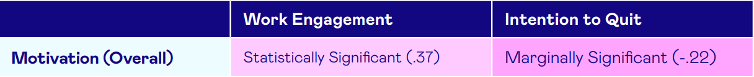
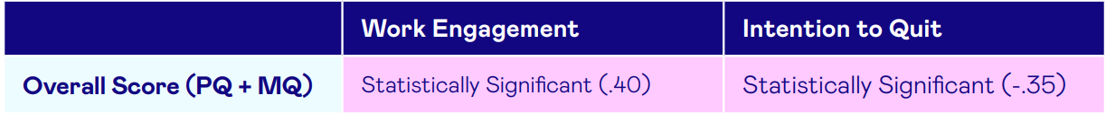
Reliability & Validity
Global talent acquisition company, 46 completions
Temporary customer service staff in Customer Service & Advisory and Processing & Administrative roles
Context and Sample
Blended assessment (PQ + MQ items) mapped to 7 key competencies
4 MQ factors assessed: customer service, curiosity, quality and stability
Plus questions relating to work engagement and intention to quit
Methodology
Findings
Using Cronbach’s Alpha, average reliability amongst the 20 MQ factors is 0.84
We’re always looking for partners to add to our research portfolio

Slide 24
Off-the-shelf Graduate SJT

Slide 25

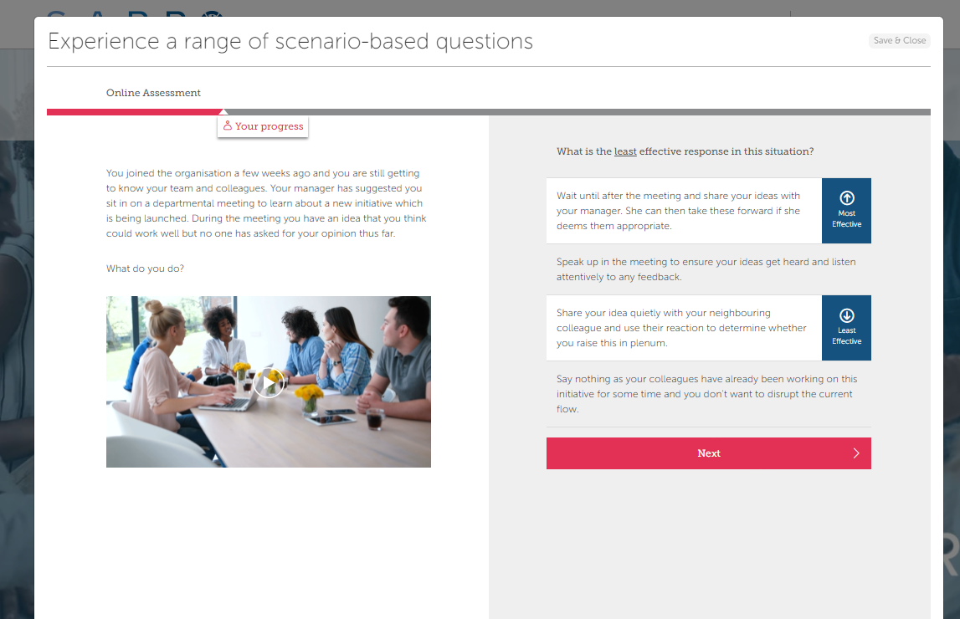
Situational Judgement
Off-the-shelf Graduate SJT
Measures 10 core competencies relevant for Graduate roles
30 questions which can be used as a full assessment or clients can choose which questions to include
Questions can be tailored to reflect the client context whilst carefully retaining psychometric properties
*Client validation study still required at this stage

Slide 26
Graduate Competencies Assessed
Example Scenarios:
Making an effort to learn about others in a working group
Teamwork
Customer Focus
Impactful Communication
Analytical Thinking and Problem Solving
Planning and Organising
Learning Focus
Resilience
Adaptability
Innovating
Drive
Working with an underperforming team member
Collaborating to overcome dysfunction within a project team
Example Scenarios:
Adapting to a new management style
Dealing with organisational restructure and new work requirements
Dealing with change in the team’s operating model

Slide 27
Sova’s Contact Centre Solution
Pre-configured assessment solution for selecting the best talent

Slide 28
Key questions we can help you answer
How to identify candidates who will perform quickly?
How to identify people who meet the role’s future evolution of more technology and managing multiple digital channels?
How to screen high volumes of applications without impacting your brand?
Who has what it takes to succeed in a challenging environment and stay with the organisation?
How can you design a fast, efficient hiring process with a lower cost of hire?
28
© 2023 Sova Assessment

Slide 29
What are we measuring?
Competency title | Competency description
Customer focus | Is naturally warm and caring towards others, and makes an effort to both understand and meet customer needs.
Working with information | Speed and accuracy in processing different types of novel information.
Influencing | Communicates confidently and assertively, and is likely to be persuasive when interacting with customers.
Adaptability | Adapts to new challenges and situations as required, and enjoys learning new things.
Basic vocabulary (English) | This test assesses how quickly and accurately the candidate can process novel verbal information and use it to draw the correct conclusions.
Drive | Is motivated and driven, and is likely to have the energy and dynamism to thrive in a fast-paced role and working environment.
Reliability | Adopts a reliable and rule-abiding working style, striving to deliver accurate and high quality outcomes and see things through to completion.
Resilience | Copes well with pressure and setbacks, and is quick to recover following setbacks or criticism.
29
© 2023 Sova Assessment

Slide 30
The Sova approach
SCREENING QUESTIONS
5000
Remove time spent sifting CVs
Accurately identify 80-90% of high performers
Improve final stage conversion ratios by 50%
Speed up Time to Hire
Narrow the recruitment funnel and make significant savings in Cost per Hire
Automated feedback for candidates
BLENDED ASSESSMENT
4500
VIDEO
INTERVIEW
1800
Final
Assessment
360
220 hires
30
© 2023 Sova Assessment

Slide 31
Beta-Learnability*
*Currently in beta-version and requires client validation

Slide 32
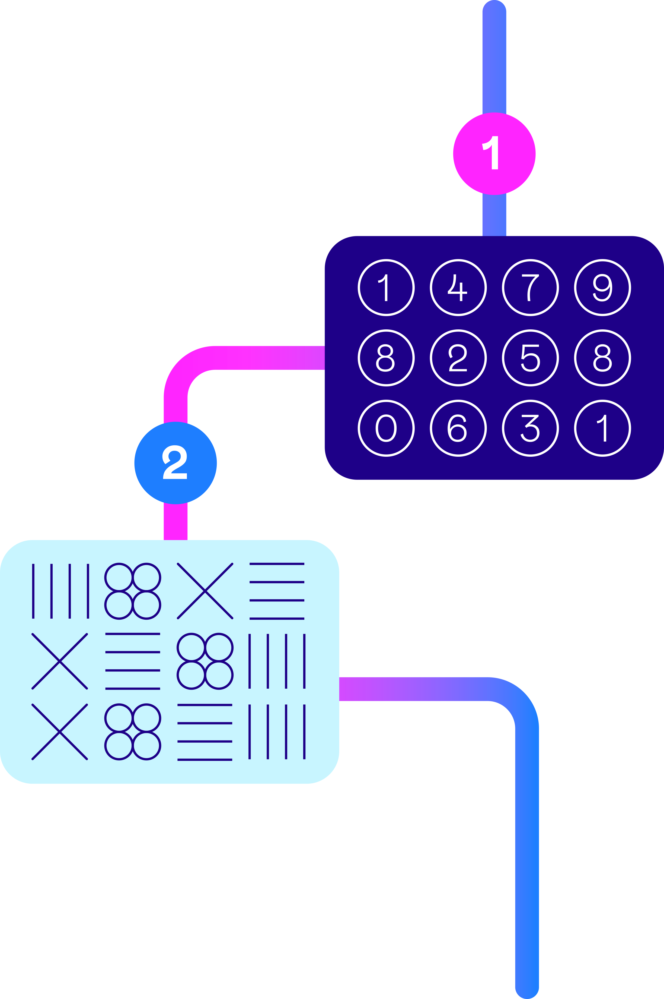
Overview of Beta-Learnability
  Online cognitive assessment designed to measure ability to learn
  Questions in the assessment are interconnected and progressively more difficult
  After a question is answered, the correct response is presented which forms part of the next, more difficult question
  Throughout the test, the test taker observes data, learns its underlying patterns, and applies their learning to solve problems
  Consists of 13 questions
  Approx. 18 minutes time to complete
  Practitioner and Candidate reports are available

Slide 33
Constructs & Roles
The test measures the ability to learn through observing data,
learning underlying patterns, and applying their learning to
solve problems.
This type of ability is required in roles that place a strong emphasis on the ability
to learn. For example,
Roles where candidates may be required to learn and acquire new knowledge and skills
Roles where candidates may need to analyse and interpret data and patterns but do not have experience with specific tools and platforms e.g. analytics roles.
The assessment has been designed to help make decisions about those applying for graduate, professional, and managerial roles (in roles where the specific criteria above is important).

Slide 34
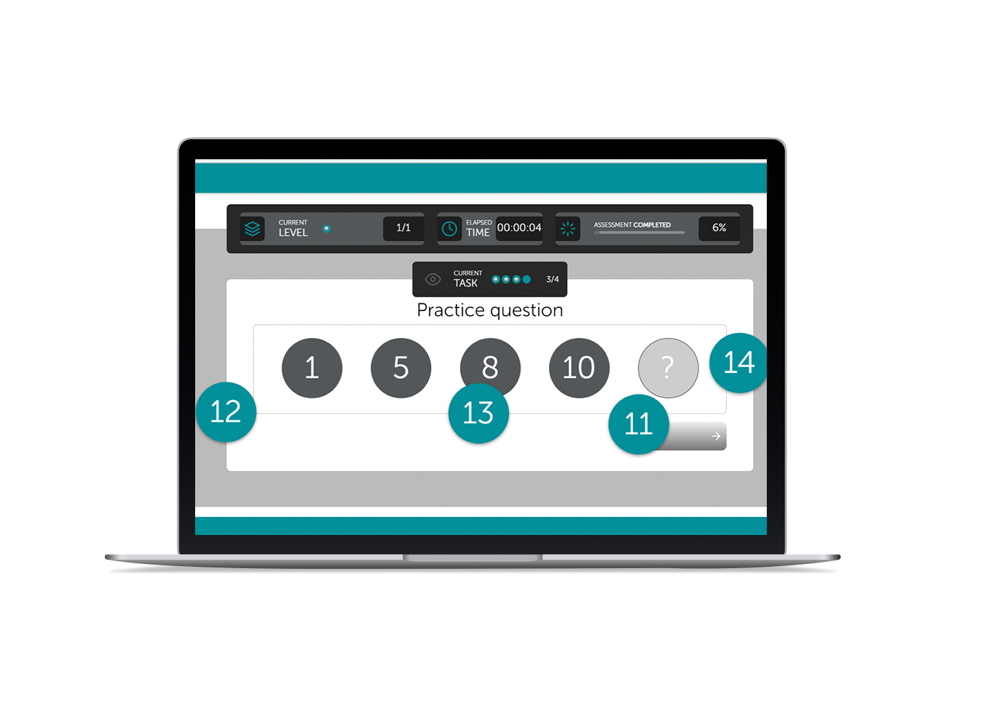
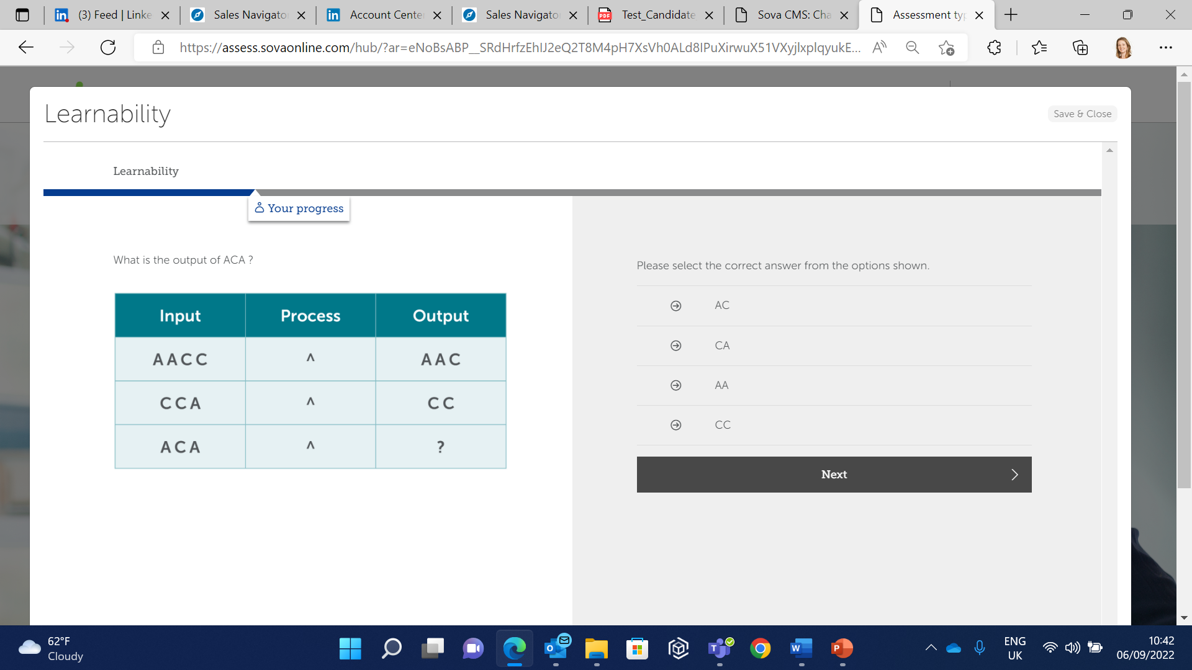
The assessment
  Test takers are presented with a series of question blocks or ‘testlets’
  Questions contain either numbers, symbols, or words, to present an underlying pattern
  Test takers choose the correct response from the presented options. As they progress to the next question in the block, the answer to the previous one is shown in order that the candidate can reflect and learn.
  Test takers use this information to solve the next, interconnected question in the testlet

Slide 35
Psychometric Properties
  Criterion Validity
  Reliability
  Criterion validity concerns the relationships between scores on an assessment and desired workplace outcomes, for example, job performance.
  Working with a large banking client, existing employees were asked to take the Learnability assessment and their line managers rated their job performance on Thinking Ability and Ability to Learn.
  Reliability concerns the precision of an assessment. Cronbach’s alpha is typically used to measure reliability (or internal consistency of questions) and the typical industry acceptable level is 0.7
  Cronbach’s Alpha
  Learnability
  0.71 (n = 1444)
  Learnability
  Thinking Ability
  0.26**
Construct Validity
  Ability to Learn
  0.20
  Numerical Reasoning
  n = 96, **p<0.01
  Learnability
  0.47** (n = 1049)

Slide 36
Beta-Learnability Assessment Fairness
  Assessment Inter-correlations
 | Effect size*
Female | -0.21
Asian | -0.02
Black | -0.53
Mixed | -0.04
20-29 | 0.19
30-39 | 0.01
40+ | -0.31
* When compared with males, white, and the ‘under 20’ group.

Slide 37
Norm Data
N=7,282
UK population, mainly grads with some apprentices and career changers
  Gender
  Age
  Ethnicity

Slide 38
Leadership Agility*
*Requires specific, in-depth training for interpretation

Slide 39
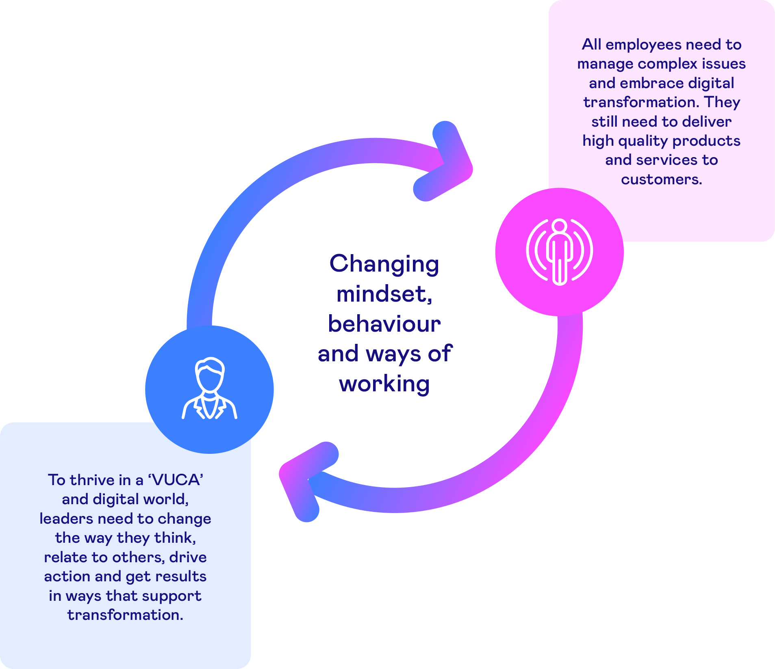
Leadership Agility
Leadership agility is about leading in a volatile, uncertain, complex and ambiguous (VUCA) world, in an era of transformational change and digitalisation.
In agile organisations, leaders create shared aspiration, build emotional alignment, ensure the capacity for change acceleration and enable the achievement of enterprise objectives.
Agility requires leaders to create the optimal cultural context for eﬀective transformational change. Agility means people are not just ready for change; they are able to harness its power.
Notes:
Technology is changing at a faster pace than organisations traditionally are set up to cope with so if we can develop more agility we can help to bridge that gap and transform our ability to adapt.
In turn, leaders need exceptional leadership agility to adapt to the changing demands around them while still focused on business results

Slide 40

Enabling Agility for a Changing World
We view agility as an individual and collective capacity to benefit from change in an intrinsically volatile, uncertain world.
This is a human capacity which is distributed across an entire organisation. It requires a
new – agile - way of thinking about strategy, innovation, product development, leadership
and organisation.
Agility drives our individual and collective ability to benefit from digitalisation and other sources of complexity in our operating environment.
Leadership
Agility
Career
Agility
Organisational Agility
Cultural
Agility
Business
Agility

Slide 41
Defining Organisational Agility
Leadership
Agility
Organisational agility stems from four mutually reinforcing elements:
Leadership Agility
A holistic approach to leading and
Cultural Agility
The ability to coach, build connections, shared clarity and commitment
Business Agility
Structural, physical and operational
Career Agility
Agile talent and performance systems that support individual aspirations
managing complex change (The 4 As)
flexibility, speed and efficiency, supporting creativity and innovation
Career
Agility
Organisational Agility
Cultural
Agility
Business
Agility
Notes:
This model is taken from Dr Kiran Chitta’s book (renowned org psych and industry expert on org agility) book Strive.
So lets look more at what makes up organisational agility:
Leadership agility – the agile approach we take to managing the complex change - essentially leaders need to change the way they think, relate to others, drive action and get results in ways that support transformations e.g creates new ways of working across the organisation.
Cultural agility - the culture we develop and whether this supports an agile mindset
Business agility – looking at the way you do business and the structures and the operations – removing barriers to working flexibly and creating innovation.
Career agility – it’s also looking at how we manage our people – e.g. old fashioned appraisal systems are not fit for purpose – things change to fast.

Slide 42
Sova’s Leadership Agility Assessment
Purpose built assessment tool targeted at leaders and high potential talent.
Focussed on assessing Leadership Agility within a VUCA environment.
Individualised report provides information on the following:
  Agility wheel: High-level summary of an individual’s results for each of the scales within the Four A’s of Agility.
  Behavioural style summary: Pinpoints strengths and areas for development in relation to an individual’s behavioural style.
  Motivators: The aspects of work which an individual is likely to find most and least motivating. How this influences orientation to transformation and change.
  Insight into action: Practical developmental advice and guidance for enhancing leadership agility.
  Managing paradox: An individual’s approach to resolving the paradoxes which will inevitably arise when managing the complexities of transformation and digitalisation.
Measuring the 4 A’s of Agility –
a holistic psychological capacity to change in a digital world

Slide 43
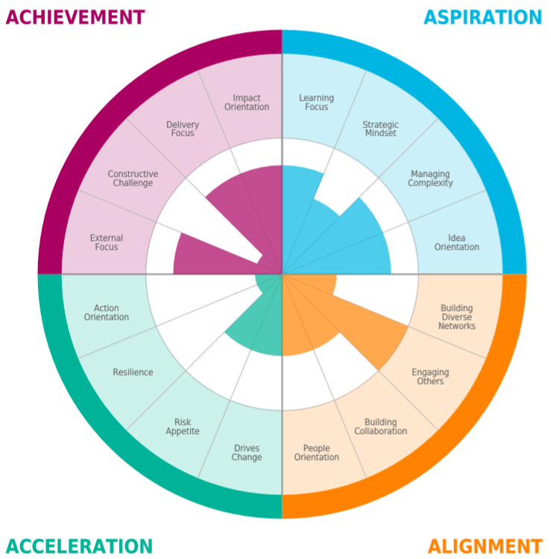
Holistic, Agile Leadership
ACHIEVEMENT
ASPIRATION
Creates impact by getting results, communicating honestly and authentically to make positive, sustained and meaningful different to customers / stakeholders
Willingness to learn in uncertain conditions, embracing new approaches, navigating effectively through ambiguity to provide strategic direction
ALIGNMENT
ACCELERATION
Engages with others, role models collaboration to create emotional alignment to a shared purpose
Acts as a catalyst for transformation, combining speed, creativity and tenacity to results, even during uncertainty

Slide 44

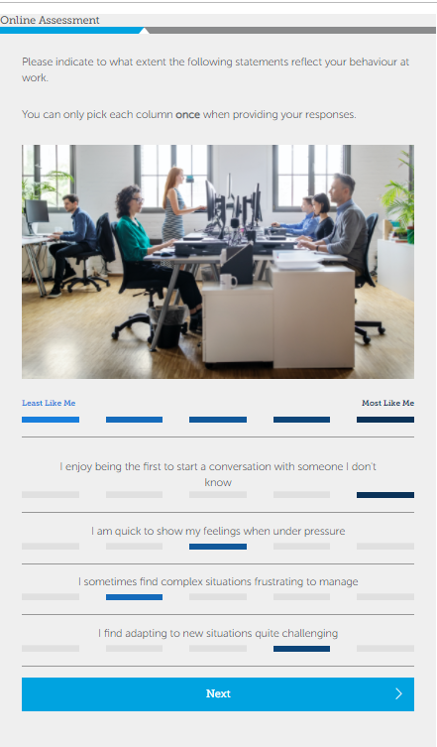
About the assessment
Provides a measure of personality preferences and
key motivators underpinned by the Four A’s of Agility.
Participants are asked to rate each statement with regards to the
extent it is like them or important to them.
The questionnaire includes an element of forced choice in
that participants cannot give the same rating to any two statements
on each screen.
This approach provides a more in-depth and granular insight
into behavioural preferences and motivators, and minimises
the ability to respond in a socially desirable way.

Slide 45
What the questionnaire is measuring
What
  Personality preferences in a workplace context
  Determined by nature and nurture, personality preferences are relatively enduring and influence how we interact with others, approach projects and tasks and manage our emotions. The likely ‘what’ of behaviour, personality influences, but does not dictate, our actions.
  Motivators in a workplace context
  Factors which drive us at work and influence the extent to which we feel energised by different work requirements or operating environments. The likely ‘why’ of behaviour, motivation tends to influence, but does not dictate, why we choose to do what we do.
Why

Slide 46
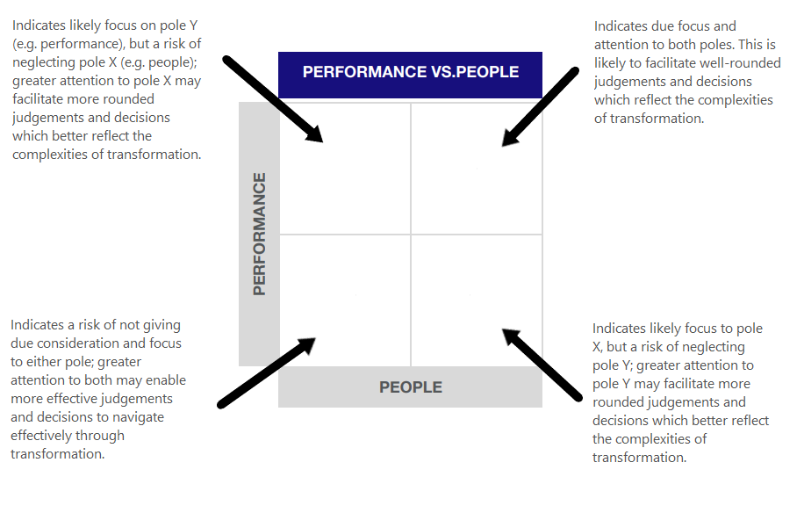
Managing paradox
The assessment also looks at the results through the lens of common paradoxes individuals are likely to face in a VUCA world.
These are two seemingly opposing, often contradictory tensions, both of which need to be considered and reconciled in order to lead effectively through change and transformation.
Results are presented in one of four quadrants, to help identify an individual’s likely orientation when faced with a dilemma of this nature.

Slide 47






Paradoxes
Paradoxes arise when we are faced with two seemingly opposing tensions, both of which need to be considered and reconciled in order to lead effectively in a VUCA world. They relate to the ability to consider both poles when forming judgements and making decisions, rather than either/ or thinking. We have identified six paradoxes which commonly arise within a transformation context:
Performance
vs. People:
Agile organisations hinge upon the ability to drive a strong result, whilst remaining aware that this can only be achieved through sufficient focus and attention to the needs, interests and wellbeing of others.
Operational
vs. Strategic:
True transformation needs to be driven by what will work in practice, as well as creating and driving a compelling vision that will enable an organisation to remain competitive in the wider
market-place.
Short term
vs. Long term: Insufficient focus to either the immediate or longer term will inevitably result in blind spots that may derail an organisation tomorrow or impact longer term sustainability and growth.
Profit
vs Purpose:
A compelling sense
of purpose wins the hearts and minds of customers, employees and shareholders alike; however, investment in this at the expense of the bottom line will impact an organisation’s
ability to function.
Continuous Improvement
vs. Innovation:
Innovative new products and services are central to an organisation remaining competitive. However, placing too much time or resource into this at the expense of continuously improving existing products, services and operations will risk destabilising the organisation.
Intuition
vs. Analysis:
Keeping up with the speed of change and transformation requires the ability to make quick decisions often with imperfect, missing or incomplete information; demanding ability to draw on both intuition and analysis.

Slide 48
Reports Available

Slide 49
Report options for recruitment and development (* can be used in both contexts)
Report name | Assessment | Summary of report
Recruitment
Trait and Narrative | Personality | A summary profile chart with dynamic text against the 18 dimensions
Sub-trait detailed report | Personality | A deep dive into all 54 sub-traits for the expert user
Competency report with interview guide | Personality | A competency based report based on a set of 10 commonly used competencies to support recruitment and interviews
Candidate narrative report | Personality | A candidate narrative summary of the 18 Sova traits
Leadership report* | Personality | A report offering insight into someone’s preferred leadership style on 8 leadership competencies
Sales recruitment report | Personality | A report based on Sova's sales model – sales cycle and sales fundamentals (candidate version also available)
Cognitive tests (user reports & candidate reports) | Verbal/Numerical/ Logical/Checking | A report showing the cognitive test scores and associated narrative (n.b. scores are not displayed in candidate reports)
Gamified tests (user reports & candidate reports) | Numerical/Logical | A report showing the gamified test scores and associated narrative (n.b. scores are not displayed in candidate reports)
Development
Team Styles report (individual and group) | Personality | A report illustrating Team types, showing how someone is likely to act in relation to 8 team styles
Potential DNA report* | Personality | A report against a set of 9 competencies designed to assess leadership potential
Derailment report | Personality | A derailment report closely aligned with the Hogan HDS report
Development report | Personality | A report which provides narrative development support on 10 commonly used competencies
Career Report | Personality | A simple report outlining commentary on a person’s score on 9 work approaches
Motivation report(s) | Motivation | A selection of four reports to aid development conversations following completion of the MQ – Coaching Report, Candidate Report*, Manager Report* and Practitioner Report*
Leadership Agility report | Leadership Agility Assessment | A in-depth report focussed on Leadership Agility, based on Sova's Leadership Agility Assessment (requires extra training for interpretation)
Notes:
**selection and development

Slide 50
Blended
Assessment

Slide 51
What are we measuring?
Motivation
& Drivers
Cognitive
Ability
Values
  Our blended approach to assessment measures situational judgement, personality and ability in one assessment to achieve a whole person view
  Everything is personalised and configured to fit the unique needs of your organisation
  A variety of formats, including video, animation, brand imagery and immersive content to keep candidates engaged and informed.
Personality
Preferences
Potential
& Experience
Competencies
Cultural
Fit
Technical
Skills &
Ability

Slide 52
Predicting high performers with high precision
Focused data and reporting
Pin-point precision
of measurement
Underpinned by an
Engaging Candidate
Experience
Configurable
robust content
What does Good Look Like

